Slide 1
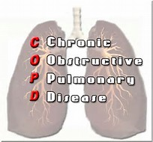
COPD Training
3 March 2017

Slide 2
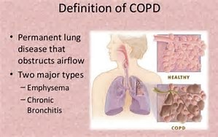
What is COPD?
Chronic obstructive pulmonary disease, or COPD, is a group of progressive lung diseases. The most common are emphysema and chronic bronchitis. Many people with COPD have both of these conditions.
Emphysema slowly destroys air sacs in your lungs, which interferes with outward air flow. Bronchitis causes inflammation and narrowing of the bronchial tubes, which allows mucus to build up.
COPD makes it harder to breathe. Symptoms may be mild at first, beginning with coughing and shortness of breath. As it progresses, it can become increasingly difficult to breathe.
You may experience wheezing and tightness in the chest. Some people with COPD have exacerbations, or flare-ups of severe symptoms.

Slide 3
What is COPD?
The top cause of COPD is smoking. Long-term exposure to chemical irritants can also lead to COPD. It’s a disease that takes a long time to develop.
Diagnosis usually involves imaging tests, blood tests, and lung function tests.
There’s no cure for COPD, but treatment can help ease symptoms, lower the chance of complications, and generally improve quality of life. Medications, oxygen therapy, and surgery are some forms of treatment.
Untreated, COPD can lead to heart problems and worsening respiratory infections.
About 24 million people in the United States have COPD. As many as half are unaware that they have it.

Slide 4
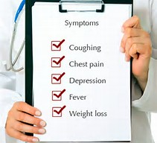
What are the signs and symptoms of COPD?
At first, symptoms of COPD can be quite mild. You might be inclined to dismiss them as a cold.
Early symptoms include:
  occasional shortness of breath, especially after exercise
  mild but recurrent cough
  needing to clear your throat often, especially first thing in the morning
You might start making subtle changes, such as avoiding stairs and skipping physical activities.
Symptoms can get progressively worse and harder to ignore. As the lungs become more damaged, you may experience:
  shortness of breath, after even mild exercise such as walking up a flight of stairs
  wheezing, or noisy breathing
  chest tightness
  chronic cough, with or without mucus
  need to clear mucus from your lungs every day

Slide 5
What are the signs and symptoms of COPD?
  frequent colds, flu, or other respiratory infections
  lack of energy
In later stages of COPD, symptoms may also include:
  fatigue
  swelling of the feet, ankles, or legs
  weight loss
Immediate medical care is needed if:
  you have bluish or gray fingernails or lips, as this indicates low oxygen levels in your blood
  you have trouble catching your breath or cannot talk
  you feel confused, muddled, or faint
  your heart is racing
Symptoms are likely to be much worse if you currently smoke or are regularly exposed to smoke.

Slide 6
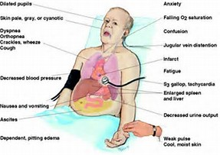
What are the signs and symptoms of COPD?

Slide 7
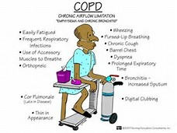

Slide 8
What causes COPD?
Single biggest cause of COPD is cigarette smoking. About 90 percent of people who have COPD are smokers or former smokers. Among smokers, 20 to 30 percent develop COPD. Many others develop lung conditions or have reduced lung function.
Most people with COPD are over 40 years old and have at least some history of smoking. The longer you smoke, the greater your risk of COPD is. Your risk of COPD is even greater if you have asthma and smoke.
You can also develop COPD if you’re exposed to chemicals and fumes in the workplace. Long-term exposure to air pollution and inhaling dust can also cause COPD.
In developing countries, along with tobacco smoke, homes are often poorly ventilated, forcing families to breathe fumes from cooking and heating fuel.
There may be a genetic predisposition to developing COPD. Up to 5 percent of people with COPD have a deficiency in a protein called alpha-1-antitrypsin. This deficiency causes the lungs to deteriorate and also can affect the liver. There may be other genetic factors at play as well.
COPD isn’t contagious!!

Slide 9
Diagnosis of COPD?
Diagnosing COPD
There’s no single test for COPD. Diagnosis is based on symptoms, a physical exam, and test results.
When you visit the doctor, be sure to mention all of your symptoms. Tell your doctor if:
you’re a smoker, or have smoked in the past
you’re exposed to lung irritants on the job
you’re exposed to a lot of secondhand smoke
there’s a family history of COPD
you have asthma or other respiratory conditions
you take over-the-counter or prescription medications
During the physical exam, your doctor will use a stethoscope to listen to your lungs as you breathe. Based on all this information, your doctor may order some of these tests to get a more complete picture:
A spirometry is a noninvasive test to assess lung function. During the test, you’ll take a deep breath and then blow into a tube connected to the spirometer.
Imaging tests include a chest X-ray or CT scan. These images can provide a detailed look at your lungs, blood vessels, and heart.
An arterial blood gas test involves taking a blood sample from an artery to measure your blood oxygen levels.
These tests can determine if you have COPD, or perhaps some other condition, such as asthma or heart failure.

Slide 10
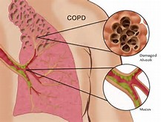
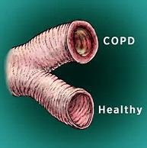
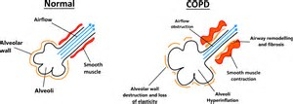
Bronchi

Slide 11
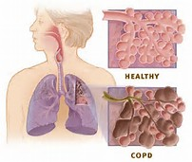
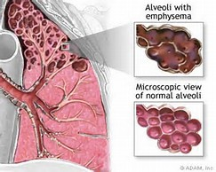
Alveoli

Slide 12
Treatment for COPD?
(Treatment can ease symptoms, prevent complications, and generally slow disease progression. Your healthcare team may include a lung specialist (pulmonologist) and physical and respiratory therapists.)
Medication
  Bronchodilators are medications that help relax the muscles of the airways so you can breathe easier. They’re usually taken through an inhaler. To lower risk of other respiratory infections, ask your doctor if you should get a yearly flu shot, pneumococcal vaccine, and a tetanus booster that includes protection from pertussis or whooping cough.
Oxygen therapy
  If your blood oxygen levels are low, you can receive oxygen through a mask or nasal prongs to help you breathe better. A portable unit can make it easier to get around.
Surgery
  Surgery is reserved for severe COPD or when other treatments have failed, which is more likely when you have emphysema. One type of surgery is called bullectomy. That’s when surgeons remove large air sacs (bullae) from the lungs. Another is lung volume reduction surgery, which removes damaged lung tissue.
Lung transplant is an option in some cases.

Slide 13
Treatment for COPD?
Lifestyle changes
  Certain lifestyle changes may also help alleviate your symptoms or provide relief.
  These include:
  If you smoke, quit. Your doctor can recommend appropriate products or support services.
  Whenever possible, avoid secondhand smoke and chemical fumes.
  Get the nutrition your body needs. Work with your doctor or dietician to create a healthy eating plan.
  Talk to your doctor about how much exercise is safe for you.

Slide 14

COPD – 4th most common cause of death in the US

Slide 15
Medication for COPD?
Medications can reduce symptoms and cut down on flare-ups. It may take a bit of trial and error to find the medication and dosage that works best for you. These are some of your options:
Bronchodilators
  Medicines called bronchodilators help loosen tight muscles around your airways. They are typically taken through an inhaler or nebulizer.
  Short-acting bronchodilators last from four to six hours. You only use them when you need them. For ongoing symptoms, there are long-acting versions you can use every day. They last about 12 hours.
Corticosteroids
  Sometimes bronchodilators are combined with inhaled glucocorticosteroids. Using the two together can reduce inflammation in the airways and lower mucus production. Corticosteroids are also available in pill form.

Slide 16
Medication for COPD?
Phosphodiesterase-4 inhibitors
  This newer medication in pill form reduces inflammation and changes mucus production. It’s generally prescribed for severe COPD.
Theophylline
  This medicine eases chest tightness and shortness of breath. It may help prevent flare-ups. It’s available in pill form.
Antibiotics and antivirals
  Antibiotics or antivirals may be prescribed when you develop respiratory infections.
Vaccines
  COPD increases your risk of other respiratory problems. For that reason, your doctor might recommend that you get a yearly flu shot, the pneumococcal vaccine, or the whooping cough vaccine.

Slide 17
Diet recommendations for COPD?
There’s no specific diet for COPD, but a healthy diet is important for maintaining overall health. The stronger you are, the more able you’ll be to prevent complications and other health problems.
Choose a variety of nutritious foods from these groups:
  vegetables
  fruits
  grains
  protein
  dairy
Drink plenty of fluids. Drinking six to eight glasses of non-caffeinated liquids a day can help keep mucus on the thin side. Limit caffeinated beverages because they can interfere with medications and increase water loss. If you have heart problems, you may need to drink less, so talk to your doctor.
Go easy on the salt. It retains water, which can strain breathing.

Slide 18
Diet recommendations for COPD?
Weight matters. It takes more energy to breathe when you have COPD, so you might need to take in more calories. If you’re overweight, your lungs and heart may have to work harder. If you’re underweight or frail, even basic body maintenance can become difficult. Overall, having COPD weakens your immune system and decreases your ability to fight off infection.
A full stomach makes it harder for your lungs to expand, leaving you short of breath. If that happens, try these remedies:
  Clear your airways about an hour before a meal.
  Swap three meals a day for five or six smaller meals.
  Save fluids until the end so you feel less full during the meal.

Slide 19
Living with COPD…
COPD requires lifelong disease management. That means following the advice of your healthcare team. There’s a lot you can do on your own, too.
Remember, your lungs are weakened. You’ll want to avoid anything that might overtax them or cause a flare-up.
Number one on the list of things to avoid is smoking. If you’re having trouble quitting, talk to your doctor about smoking cessation programs. Try not to be around secondhand smoke, chemical fumes, air pollution, and dust.
A little exercise each day can help you stay strong. Talk to your doctor about how much exercise is good for you.
Maintain a diet of nutritious foods. Avoid highly processed foods that are loaded with calories and salt but lack nutrients.

Slide 20
Living with COPD…
If you have other chronic diseases along with COPD, it is important to manage those as well, particularly diabetes and heart disease.
Clear the clutter and streamline your home so that it takes less energy to clean and do other household tasks. If you have advanced COPD, get help with daily chores.
Be prepared. Carry your emergency contact information with you and post it on your refrigerator. Include information about what medications you take, as well as the doses. Program emergency numbers into your phone.
It can be a relief to talk to others who understand. Consider joining a support group. The COPD Foundation provides a comprehensive list of organizations and resources for people living with COPD.

Slide 21
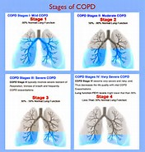
Oxygenated part
Not oxygenated part

Slide 22
Connection between COPD and lung cancer?
All around the world, COPD and lung cancer are major health problems. These two diseases are linked in a number of ways.
COPD and lung cancer have several common risk factors. Smoking is the number one risk factor for both diseases. Both are more likely if you breathe secondhand smoke, or are exposed to chemicals or other fumes in the workplace.
There may be a genetic predisposition to developing both diseases. Also, the risk of developing either COPD or lung cancer increase with age.
Between 40 and 70 percent of people with lung cancer also have COPD.
A 2015 study suggests they may actually be different aspects of the same disease, and that COPD could be a driving factor in lung cancer.
In some cases, people don’t learn they have COPD until they’re diagnosed with lung cancer.
Of course, having COPD doesn’t necessarily mean you’ll get lung cancer. You do have a higher risk though. That’s another reason why, if you smoke, quitting is a good idea.

Slide 23
COPD statistics
Worldwide, about 65 million people have moderate to severe COPD. About 12 million adults in the United States have a diagnosis of COPD. It’s estimated that 12 million more have the disease, but don’t know it yet.
Most people with COPD are 40 years of age or older.
The majority of people with COPD are smokers or former smokers. Smoking is the most important risk factor that can be changed. Between 20 and 30 percent of chronic smokers develop COPD.
Between 10 and 20 percent of people with COPD have never smoked. In up to 5 percent of people with COPD, the cause is a genetic disorder involving low levels of a protein called alpha-1-antitrypsin.
COPD is a leading cause of hospitalizations in industrialized countries. In the United States, COPD is responsible for over 700,00 hospital admissions per year and over 1.5 million emergency department visits. Among people with lung cancer, between 40 and 70 percent also have COPD.
About 120,000 people die from COPD each year in the United States. It’s between the 3rd-4th leading cause of death in the United States. More women than men die from COPD each year.
It is projected that the number of COPD cases will increase by more than 150 percent from 2010 to 2030. Much of that can be attributed to an aging population.

Slide 24
How will COPD affect a life?
COPD tends to progress slowly. You may not even know you have it during the early stages.
Once you have a diagnosis, you’ll need to start seeing your doctor on a regular basis. You’ll also have to take steps to manage your condition and make the appropriate changes to your daily life.
Early symptoms can be managed, and certain lifestyle choices can help you maintain a good quality of life for some time.
As the disease progresses, symptoms can become increasingly limiting.
In severe stages of COPD, you may not be able to care for yourself without assistance. You’re at increased risk of developing other respiratory infections, heart problems, and lung cancer. You may also be at risk of depression.
COPD generally reduces life expectancy, though the outlook varies considerably from person to person. People with COPD who never smoked may have a modest reduction in life expectancy, while former and current smokers are likely to have a larger reduction.
Besides smoking, your outlook depends on how well you respond to treatment and whether you can avoid serious complications. Your doctor is in the best position to evaluate your overall health and give you an idea about what to expect.

Slide 25
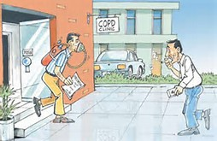
Thank you

