Slide 1
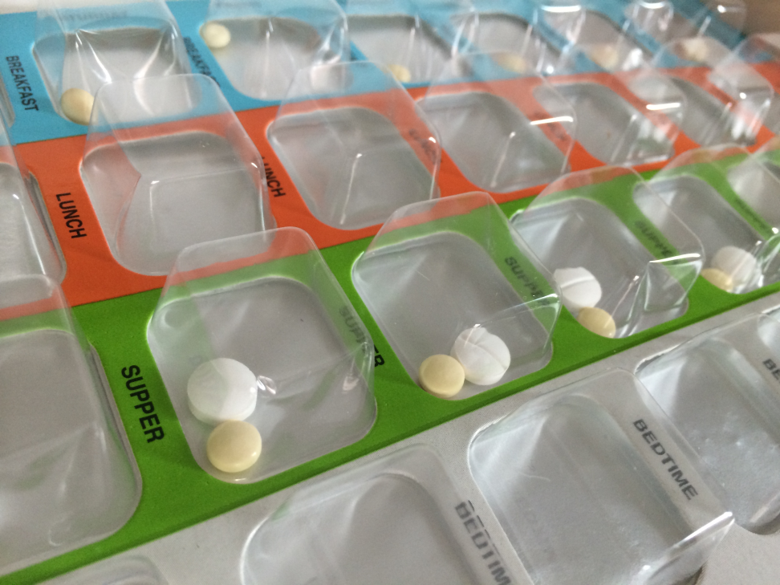


14 June 2018

Slide 2
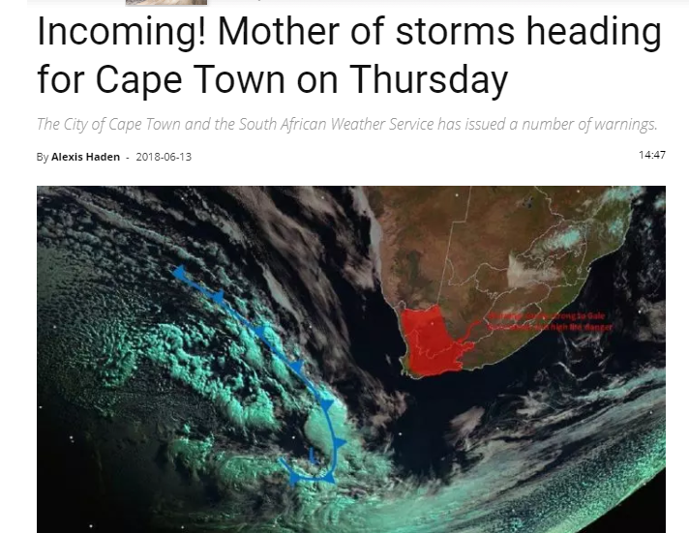


Slide 3
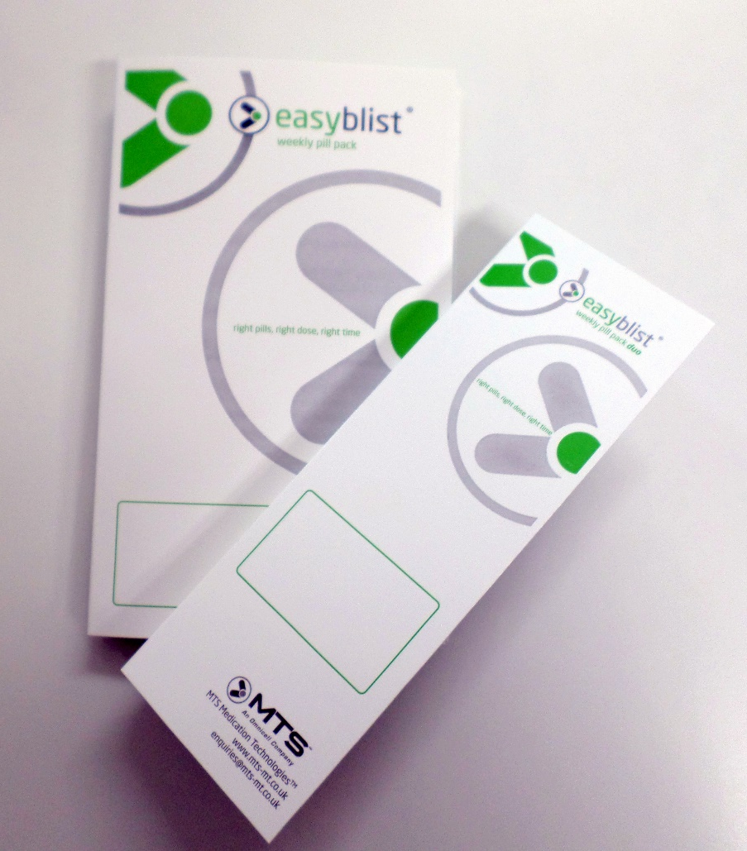
Agenda
Who is DTS?
What is the Easyblist System?
Legislation
Compelling reasons to introduce Easyblist blister packs in your care home
Blister Packing Pharmacies…what they look like.

Slide 4
Who is DTS?
Keeping people independent for longer

Slide 5


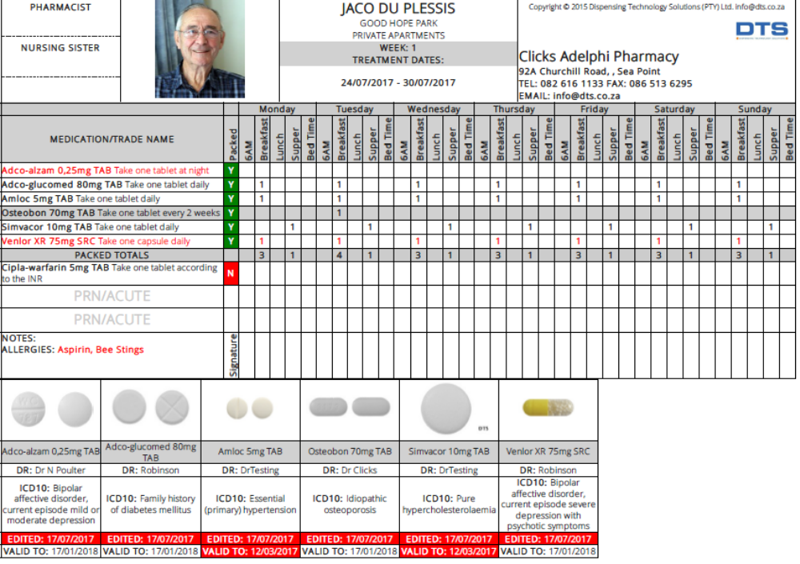
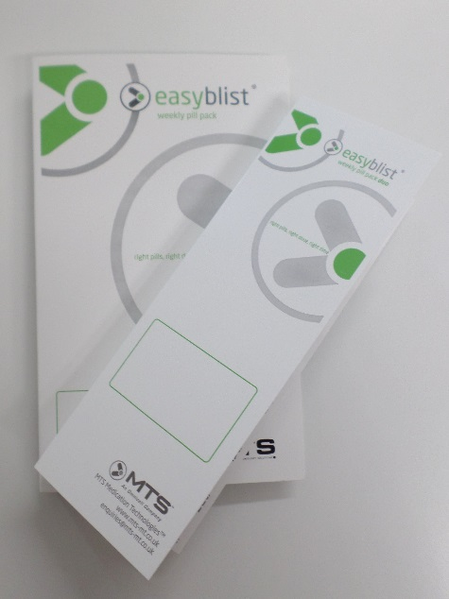
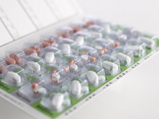
The Easyblist System
The Weekly Blister Pack
  Small (2 columns)
  Large (4 columns)
The Treatment Plan

Slide 6

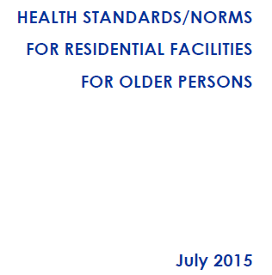
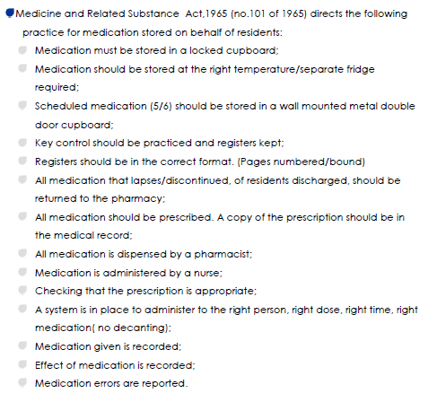
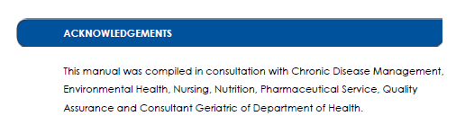
Legislation and Auditing

Slide 7
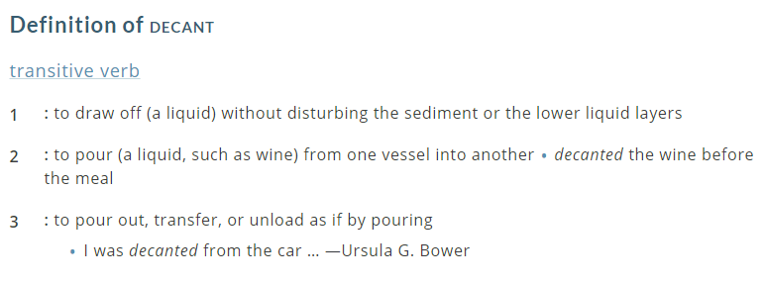

Slide 8
10 compelling reasons to introduce blister packing as part of medication management in a care home
Safety
Accuracy & Precision
Improved control
Convenient
Cost-effective
Time-saving
Space-saving
Hygienic
Clear liability shift
Reinforces relationships with healthcare team

Slide 9
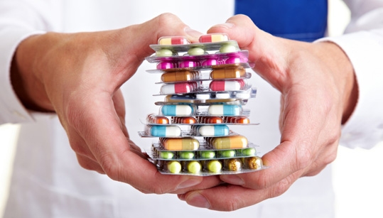
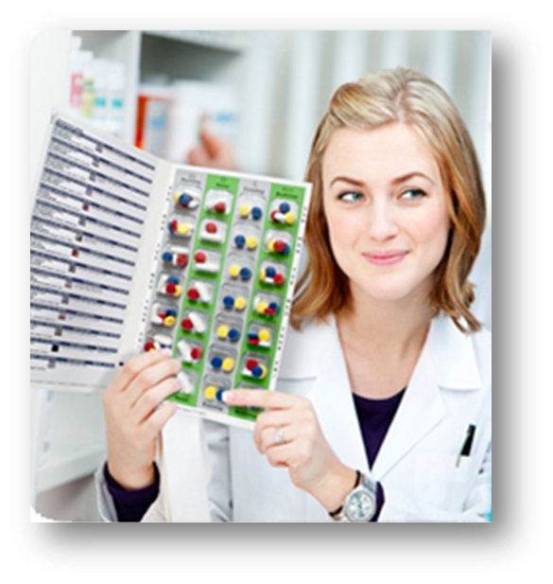
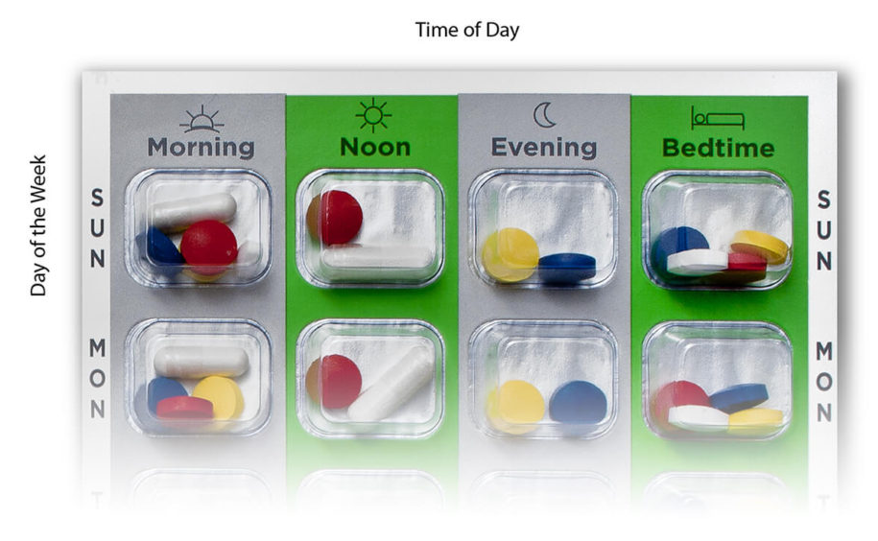
SAFETY
Easyblist ensures that the right medication is given to the right resident at the right time with the easy-to-follow format and simple treatment plan that provides instant visual reinforcement of what has been administered.
All blister packs are tamper-evident.
The drug interaction checker reduces the risk to the patients’ health.

Slide 10
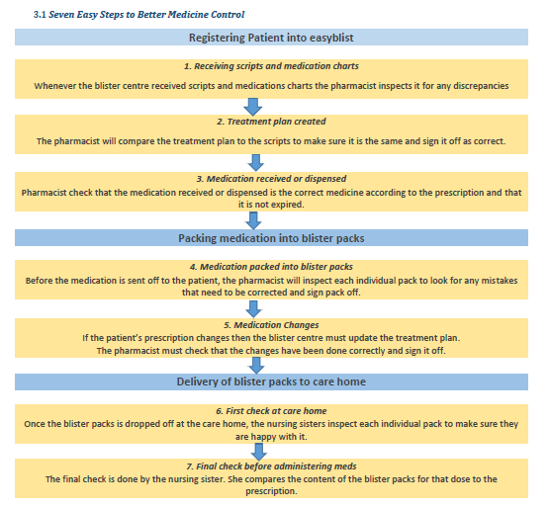
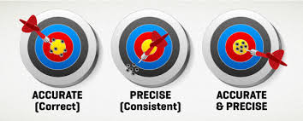
ACCURACY &
PRECISION
Blister packs are checked at the pharmacy and at the care home to ensure that the medication and information is correct.

Slide 11
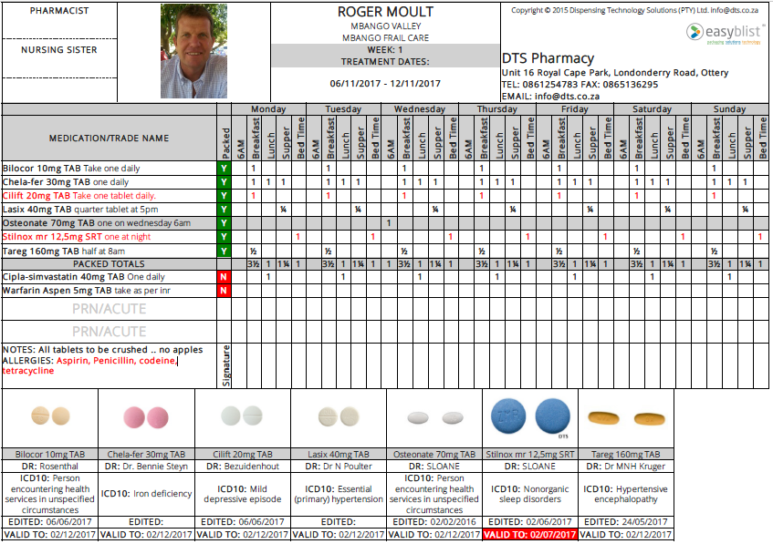
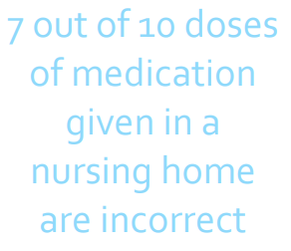

IMPROVED CONTROL
Each resident has their own treatment plan which is signed after the administration of medication.
No recording of packed S5
medication

Slide 12
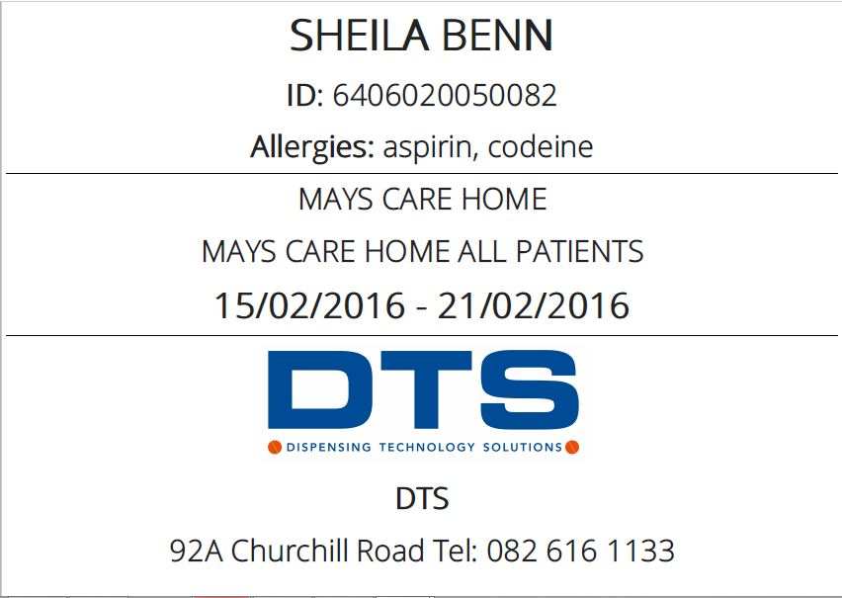
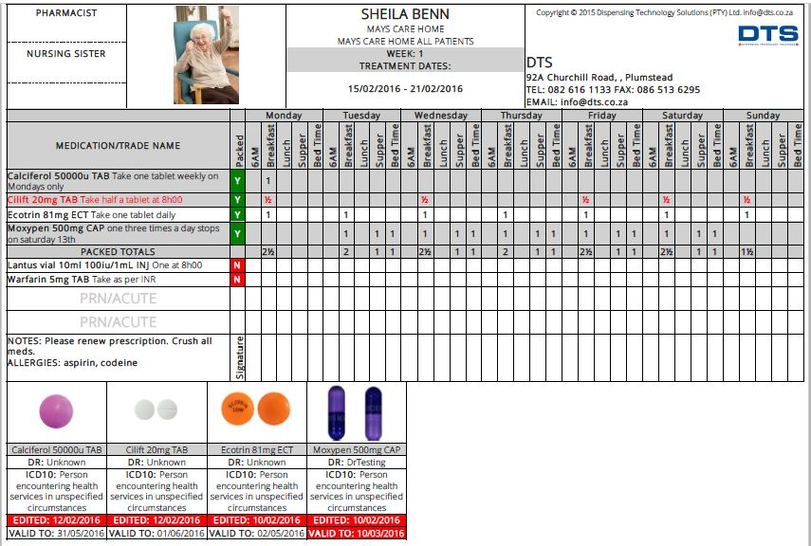
6. Validate the treatment plan :
(refer to SOP CH 003)
d. Ensure that a correct label is attached to the spine of the blister pack
e. Ensure that the pharmacist has signed the treatment plan and the blister pack
f. Check the profile photograph of the resident, name, ID and treatment dates
g. Check the listed medication and dosing according the most recent script

Slide 13
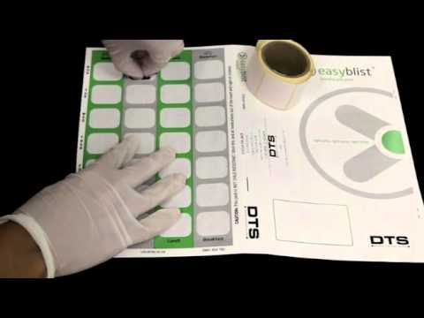
CONVENIENT
Weekly delivery of packs for the forthcoming week ensures that costs are minimised if changes need to be made.
All solid-dose medications can be packed, including non-scripted items.
The Treatment Plan replaces the medication Chart.

Slide 14
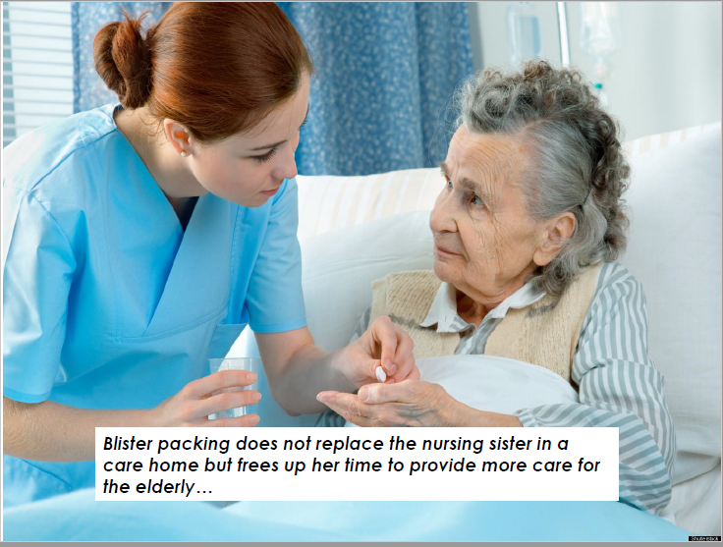
COST-EFFECTIVE
Minimises the time spent counting pills and maximises the opportunity for care

Slide 15
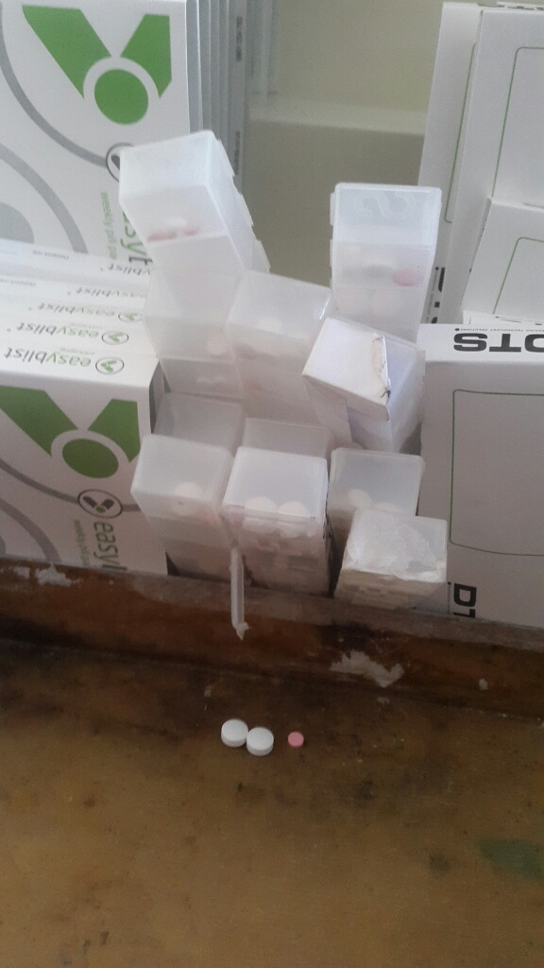
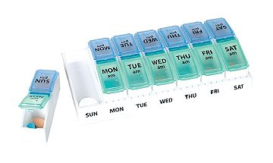
TIME-SAVING
No more counting and dispensing of pills.
The dispensing into named packs is done at the pharmacy.
Nurses have more time to care for residents since they spend less time doing admin and pill packing.
Nurses are less stressed and fatigued.

Slide 16
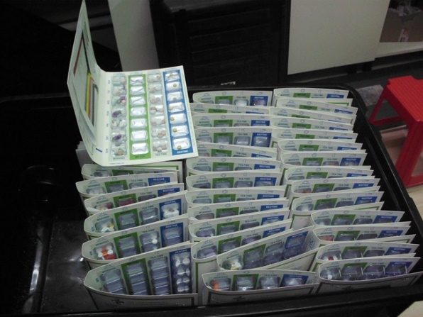
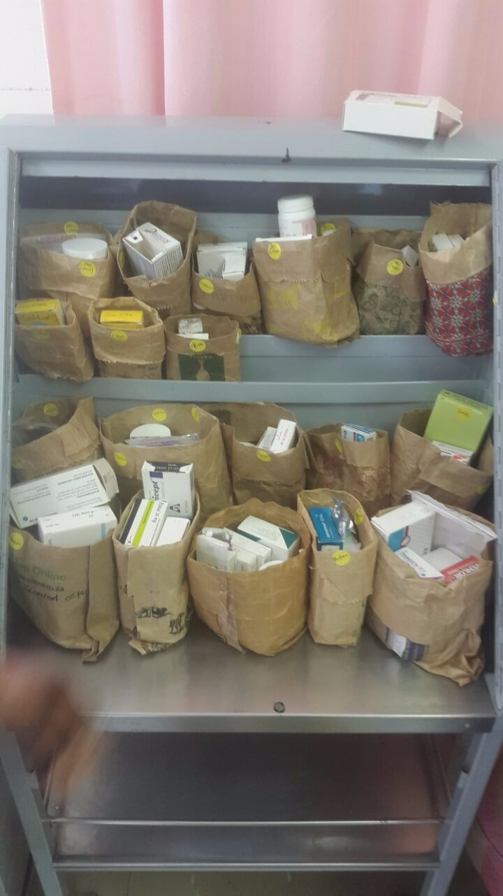
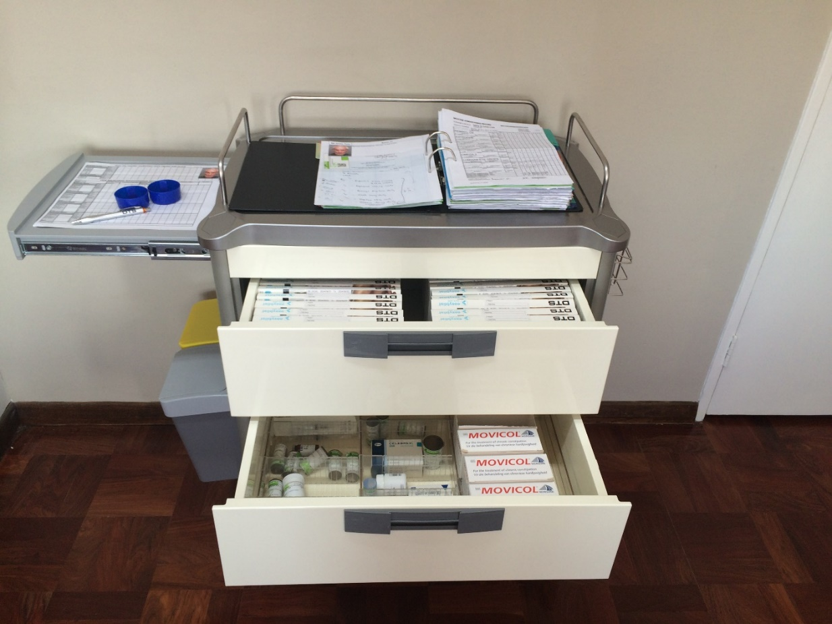
SPACE-SAVING
Unused medication is kept at the pharmacy until it is required.
Blister packs are delivered weekly for use the following week.

Slide 17
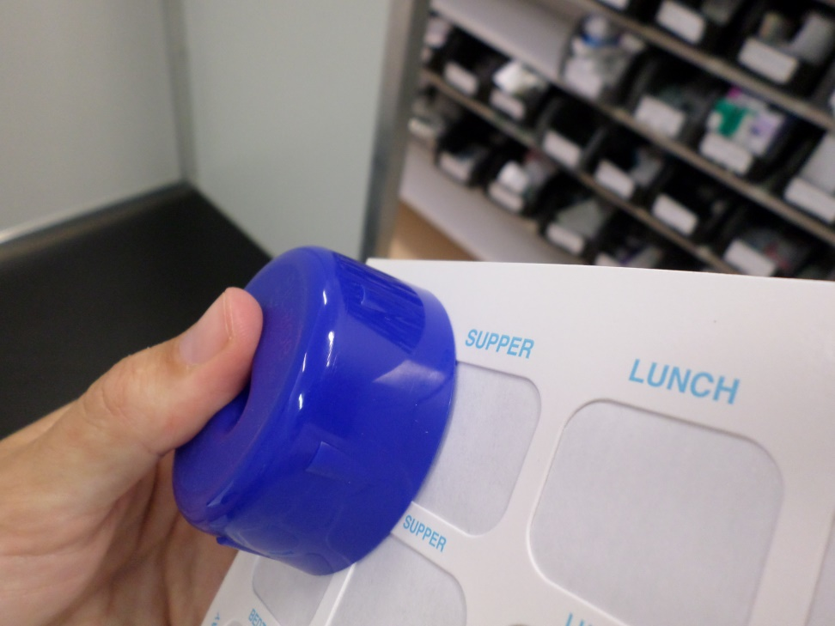
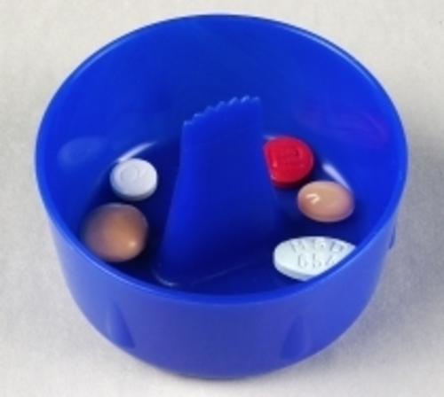
HYGENIC
No more dirty dosettes or pill vials.
The easyblist pill-bob ensures the pills do not come into contact with anyone's hands.

Slide 18
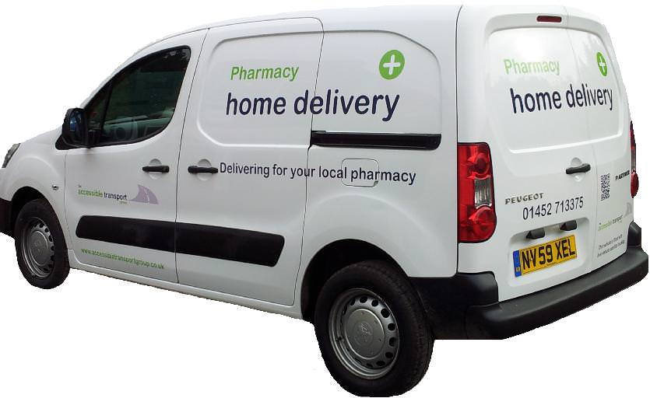
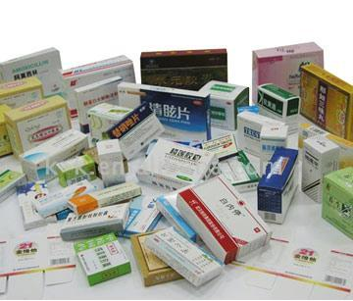
CLEAR LIABILITY SHIFT
Without blisters…liability ends at the front door
With blisters…liability transfers to the nursing staff only once the individual blister has been opened.

Slide 19






Blister Packing Administration
Scope of Practice
Roles and Responsibilities | Professional Nurse (RN) | Enrolled Nurse (EN/Staff) | Enrolled Nurse Assistant (ENA) | Carer
Identify | √ | √ | √ | √
2. Approve | √ | × | × | ×
3. Administer | √ | √ | × | ×
4. Monitor and Observe | √ | √ | √ | √
5. Record | √ | √ | √ | √
6. Store | √ | √ | √ | √

Slide 20
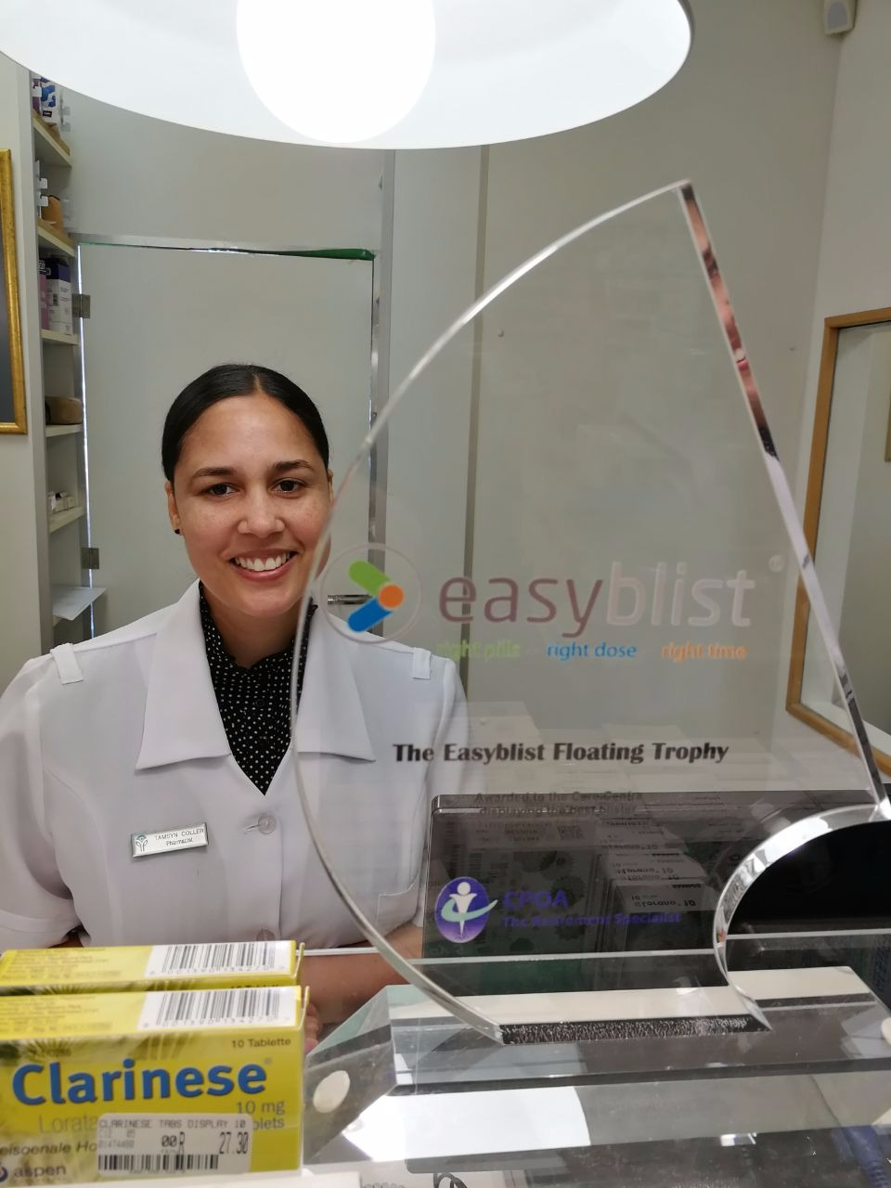
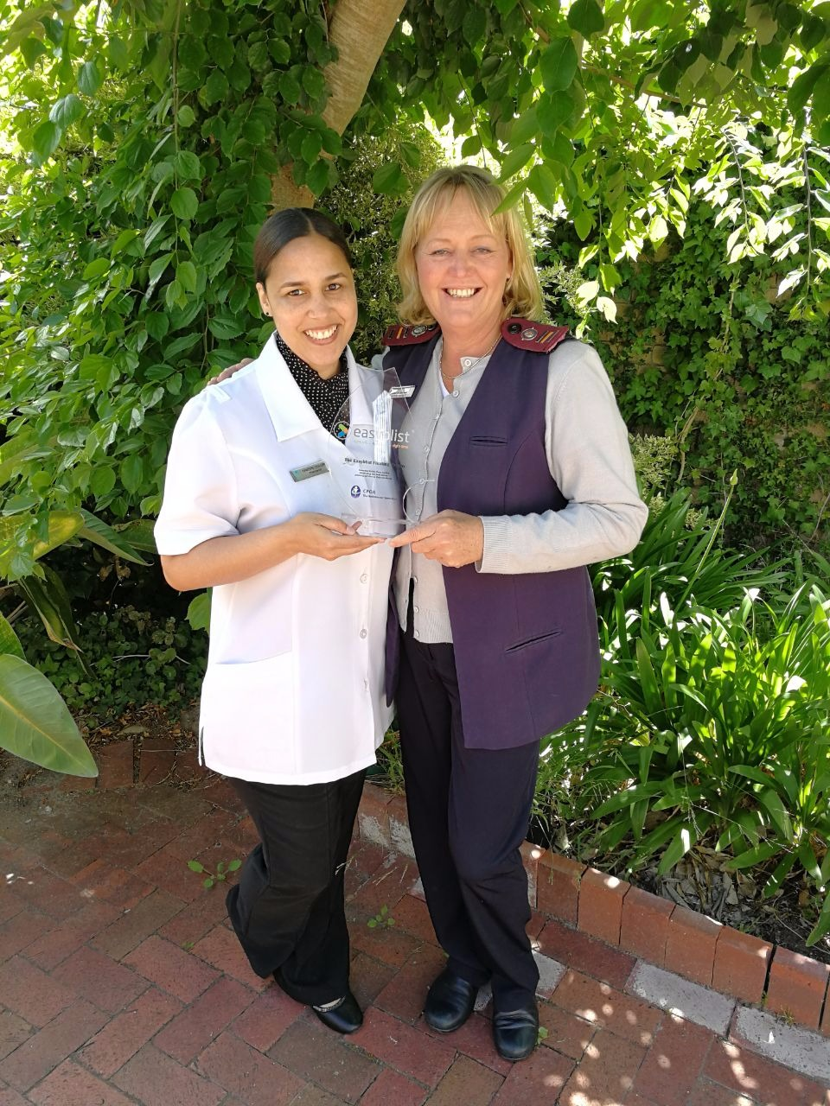
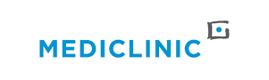
REINFORCES RELATIONSHIPS WITH THE HEALTHCARE TEAM
The treatment plan gives the healthcare practitioner a holistic view of the medication regimen at any given time
Doctor’s and Specialists are recommending blister packing
Hospitals are welcoming the initiative.

Slide 21
Who benefits from using easyblist?
People who:
has specific, chronic or multiple disease states
receive multiple prescriptions from different doctor’s
have been prescribed complex dosing instructions
require assistance with taking their medication.

Slide 22
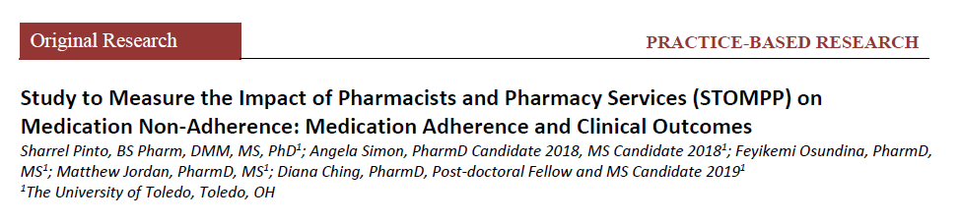
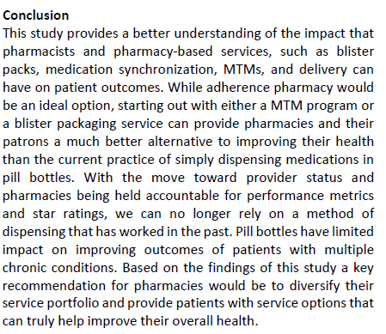
Research using Easyblist packs

Slide 23
Medication: Self-Administration Assessment
Can you correctly state what each medication is used for?
Can you correctly state the proper dosage of each medication you take?
Can you correctly state what time of the day your medication should be taken?
Can you open each medication container?
Can you correctly measure the appropriate amount of medication from the container?
Can you demonstrate the ability to self-administrate the medication?
Can you demonstrate the ability to close the medication container correctly?
Can you demonstrate the secure storage of the medication?
If you answer NO to any of these questions then easyblist would be ideal for you

Slide 24
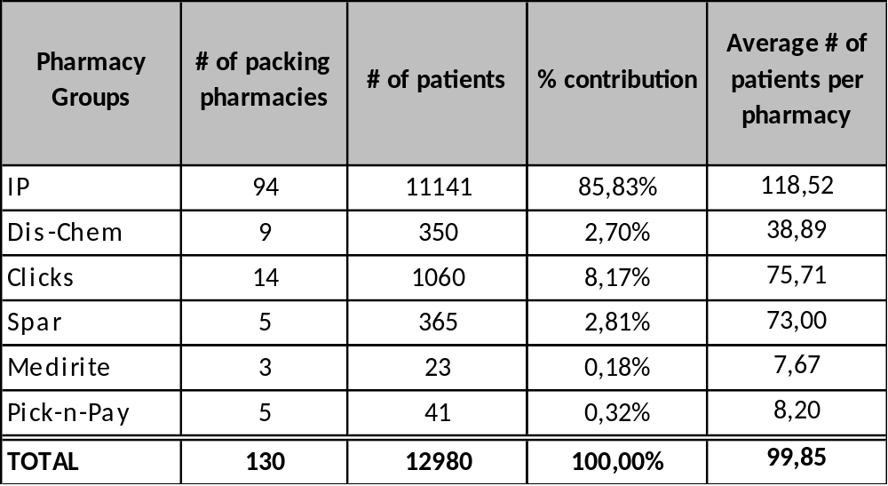
Easyblist Pharmacies

Slide 25
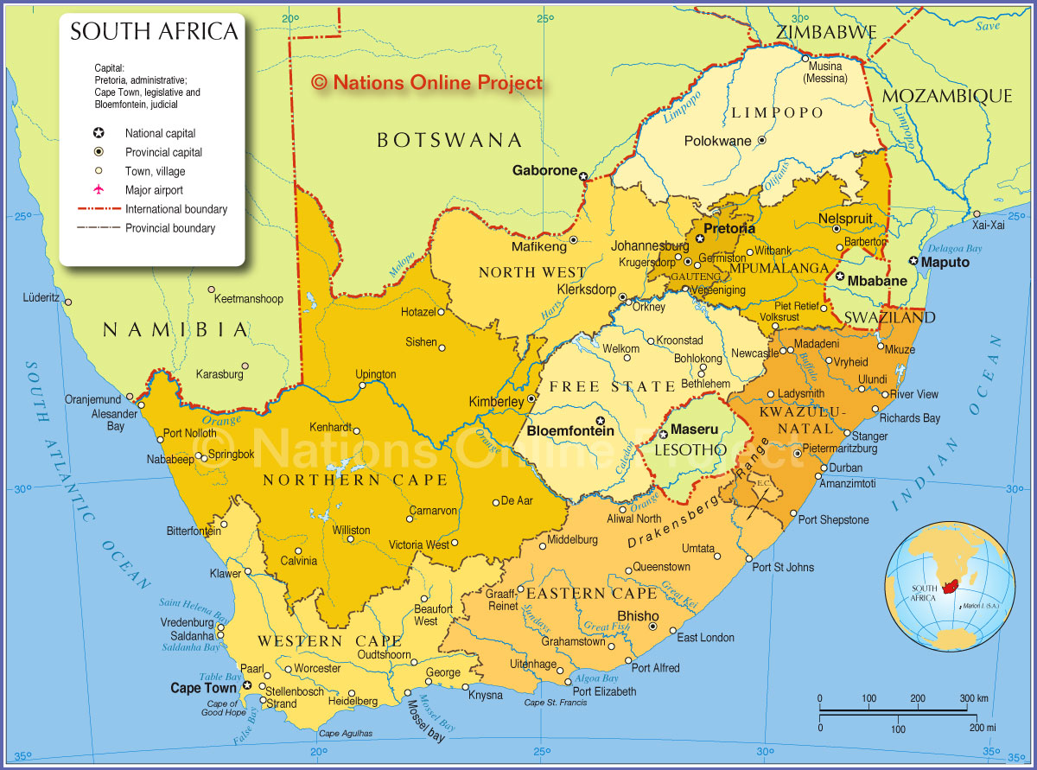

130 pharmacies offering the Easyblist service
13,800 patients receiving Easyblist
570 care homes

Slide 26
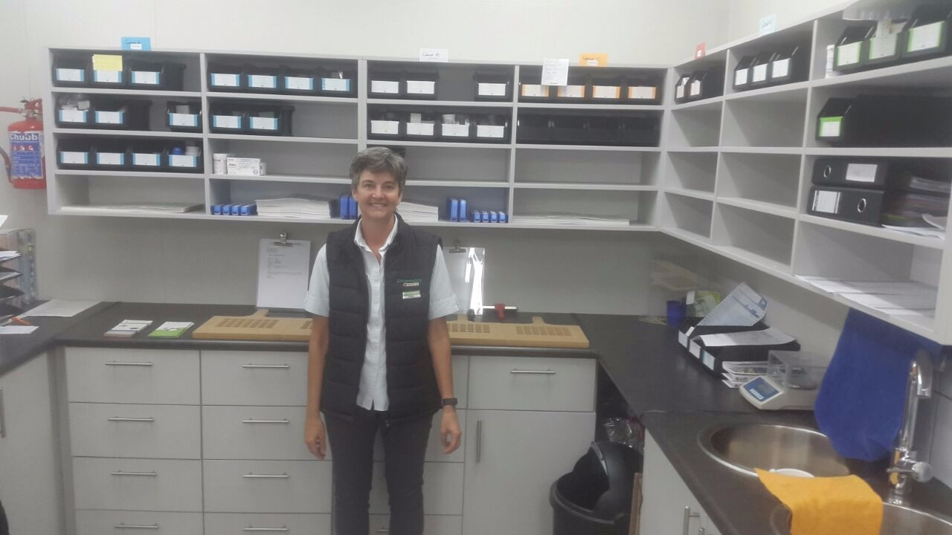

Slide 27
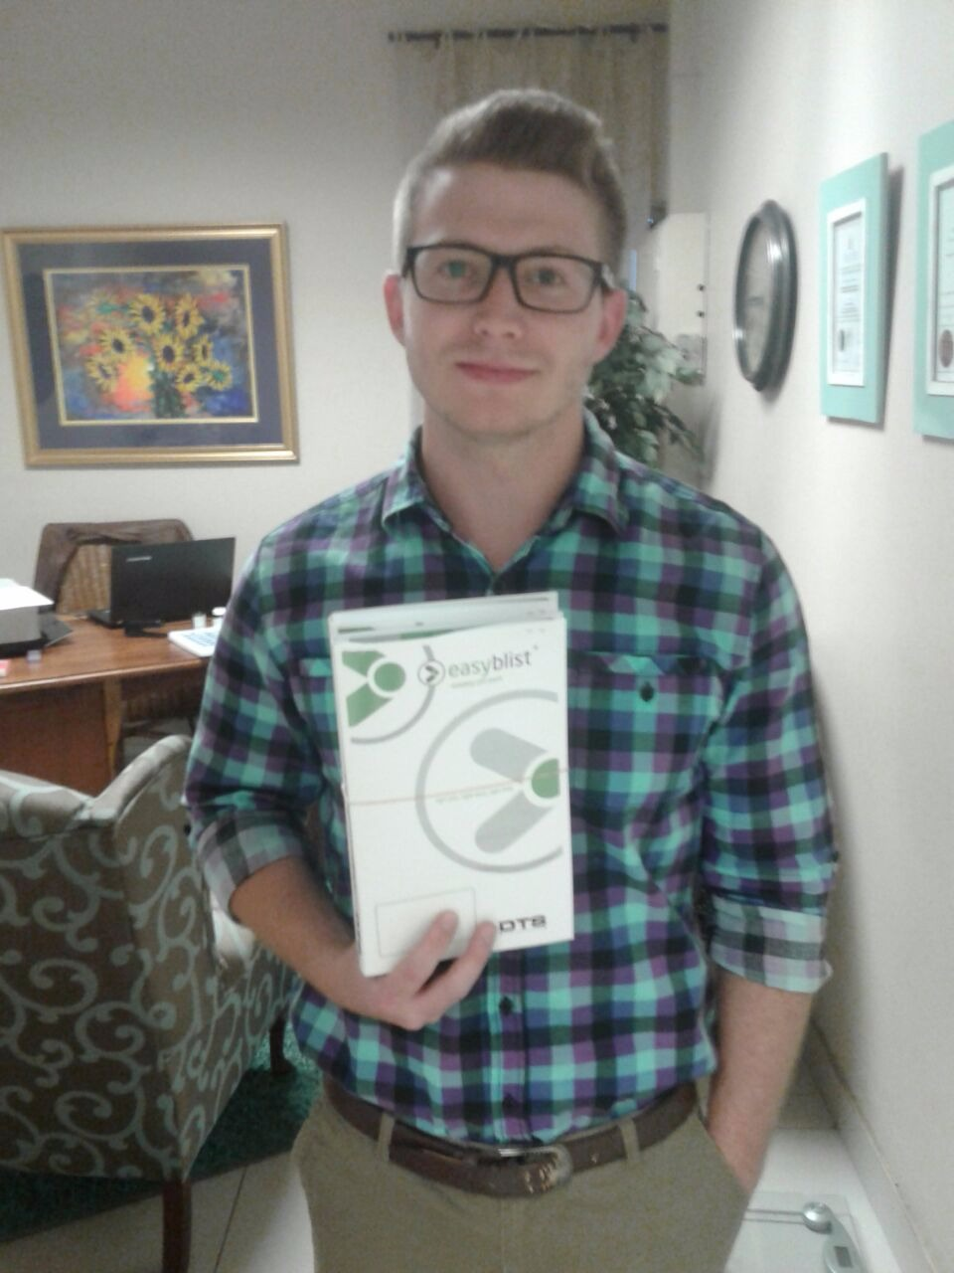
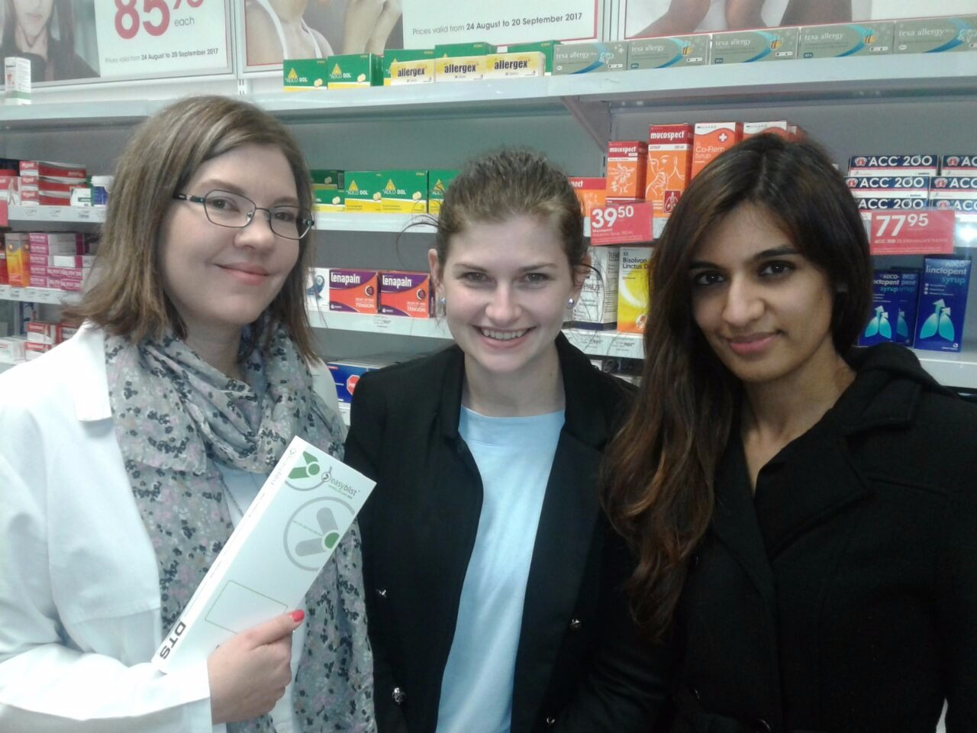
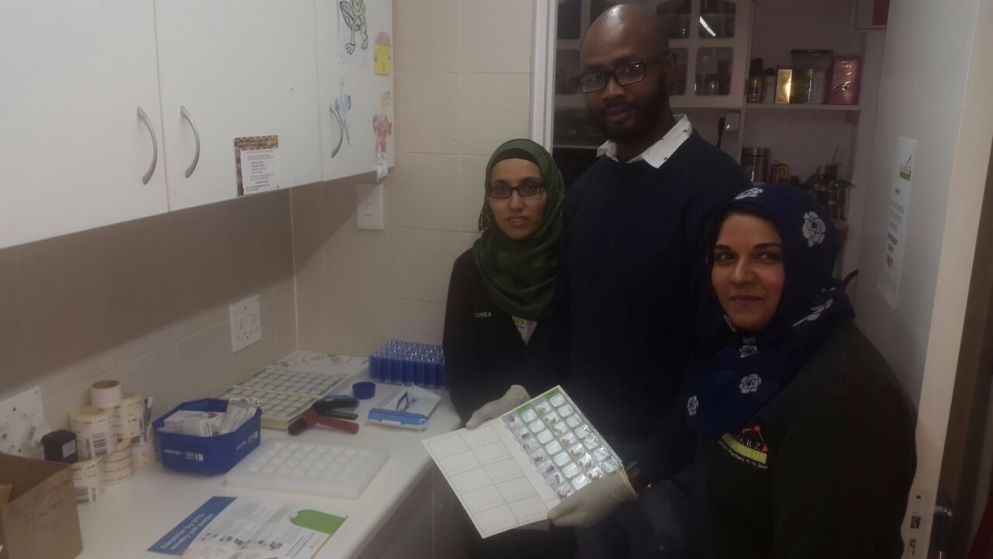
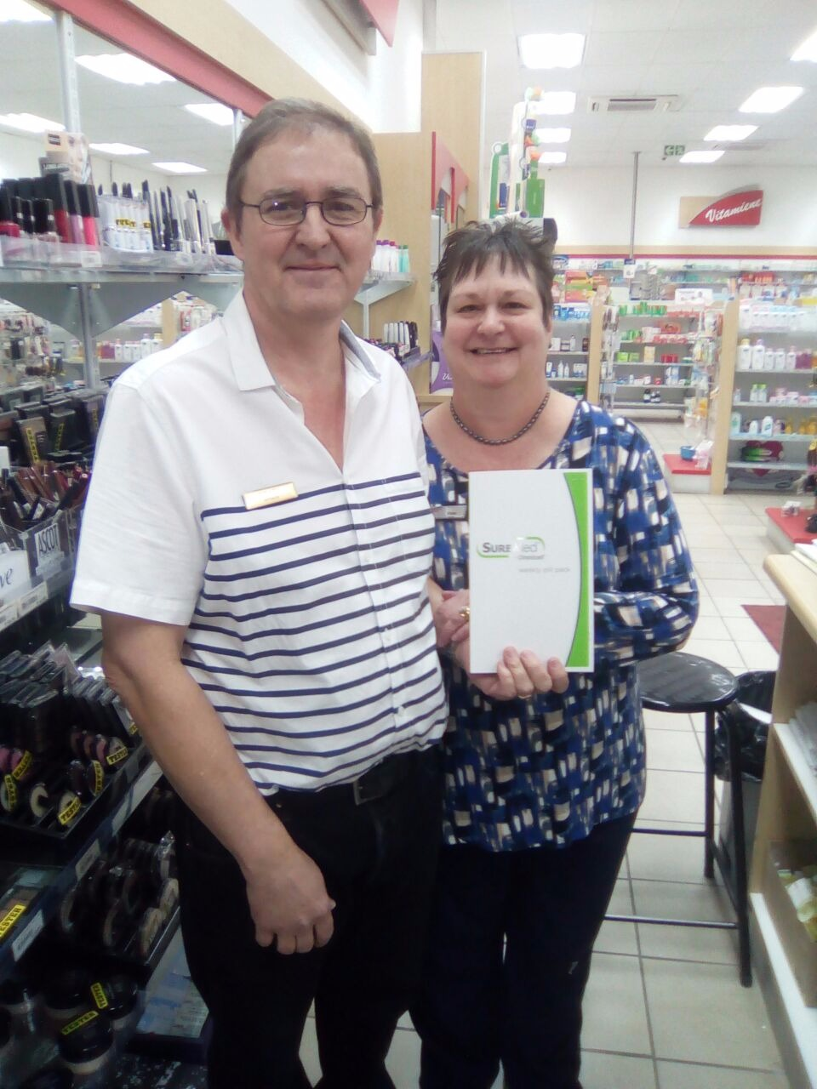
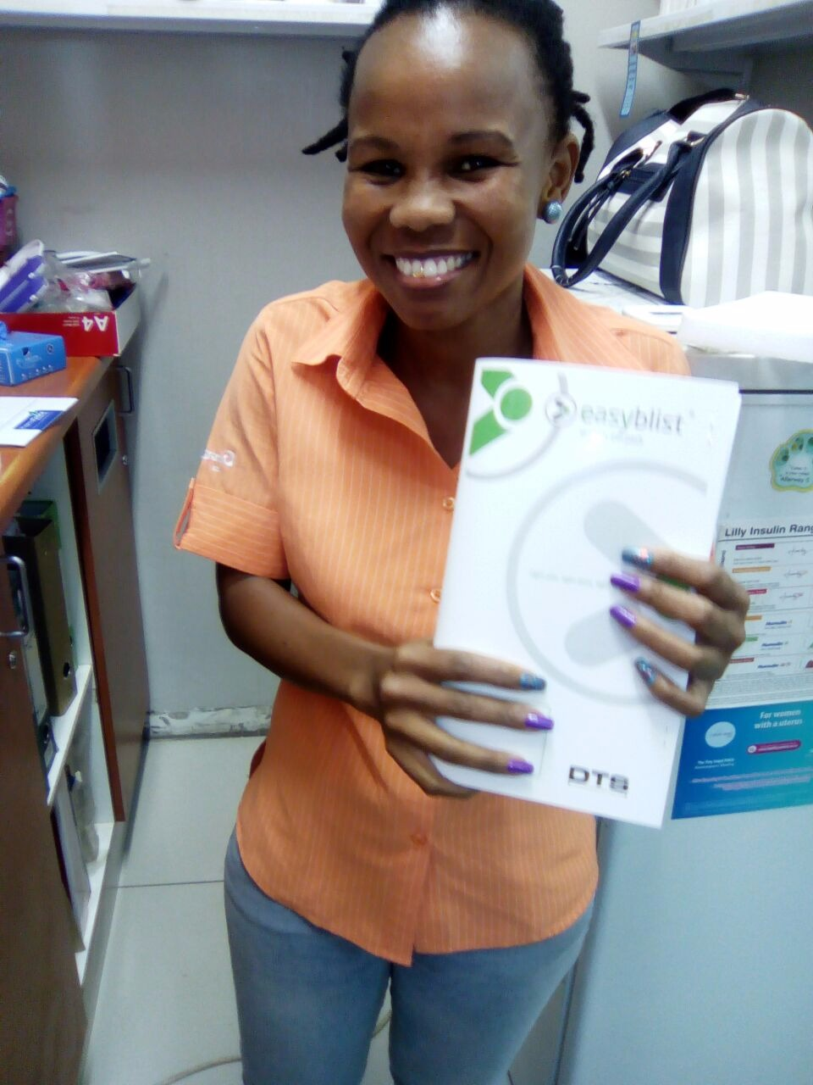
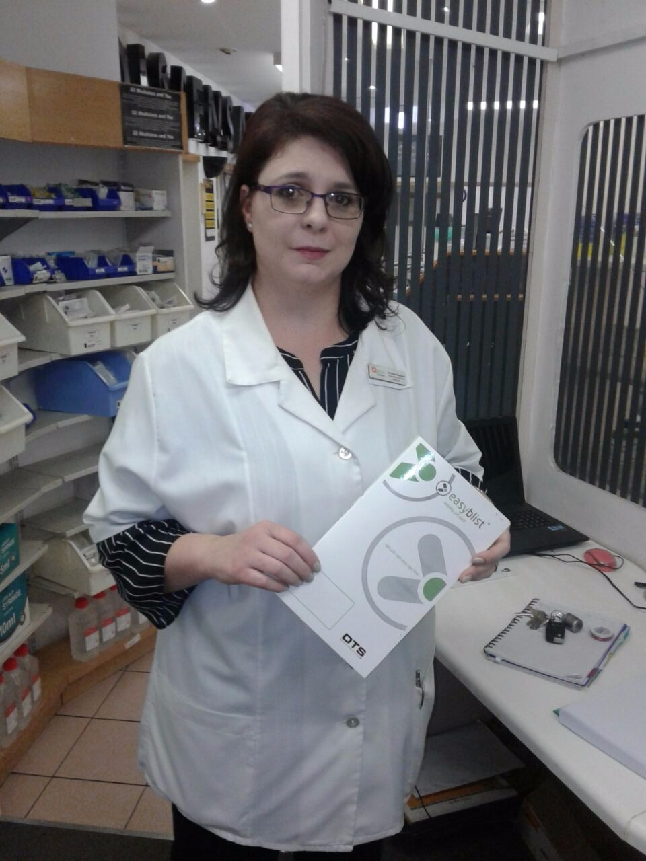

Slide 28
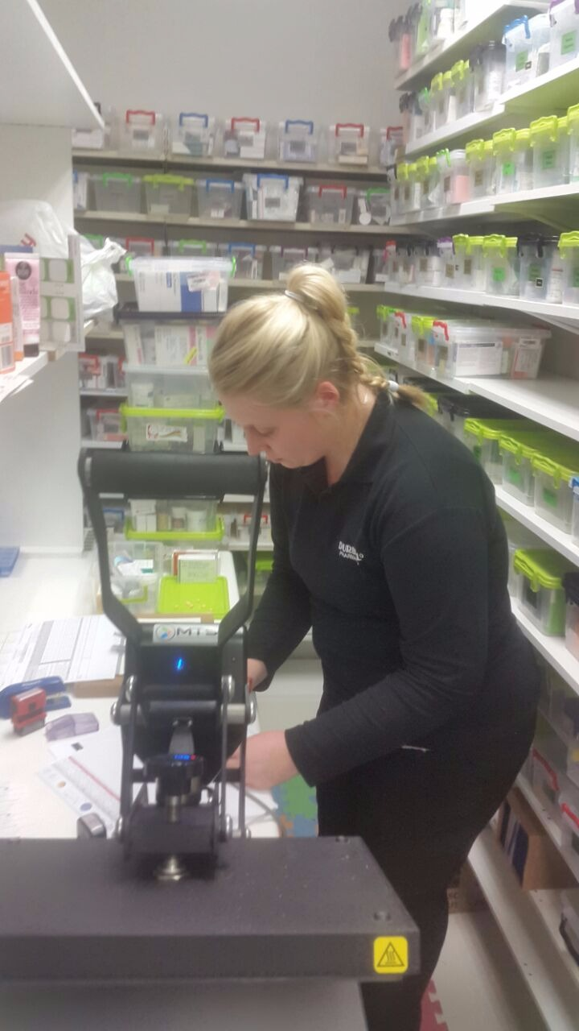
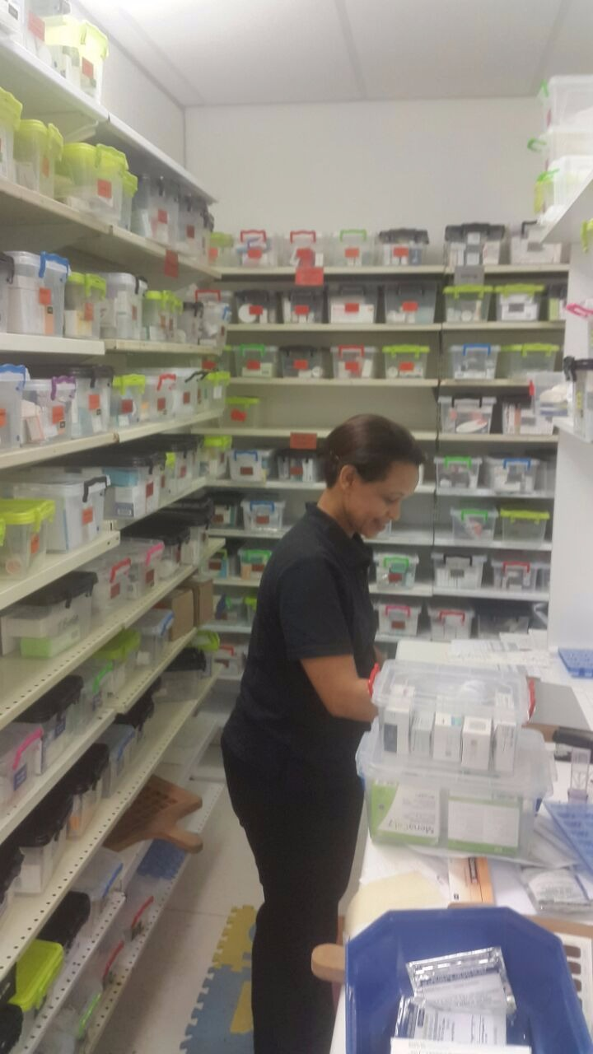
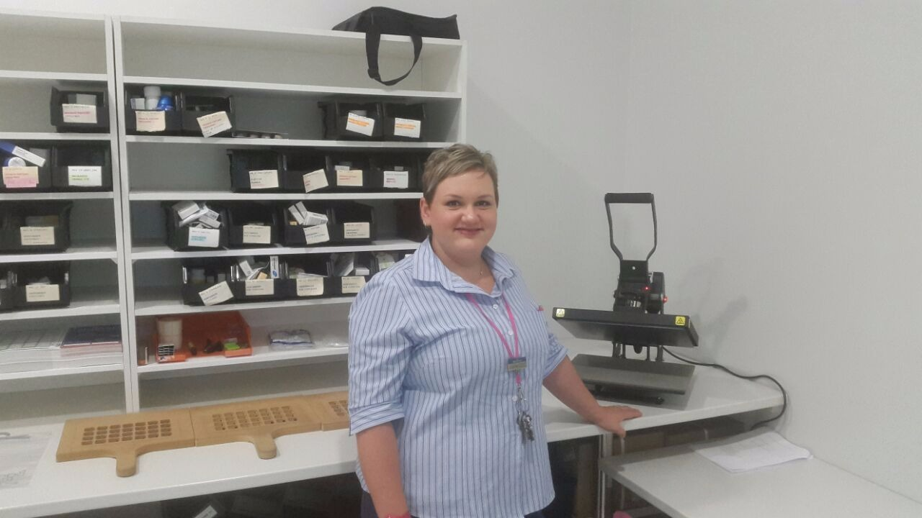
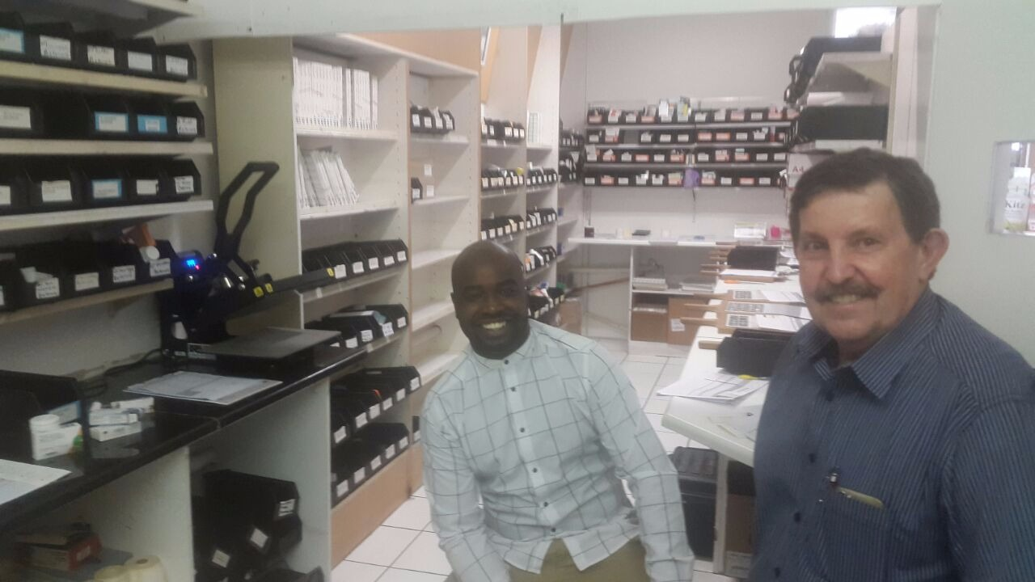
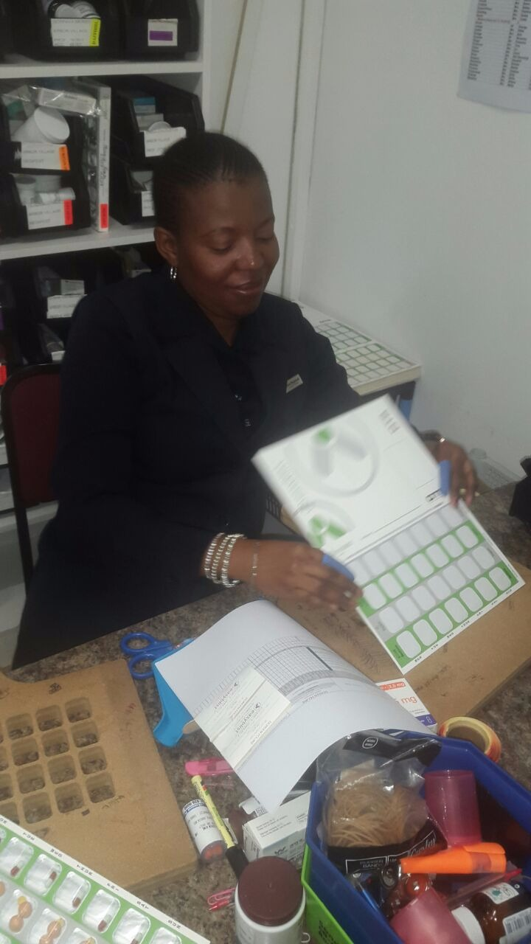
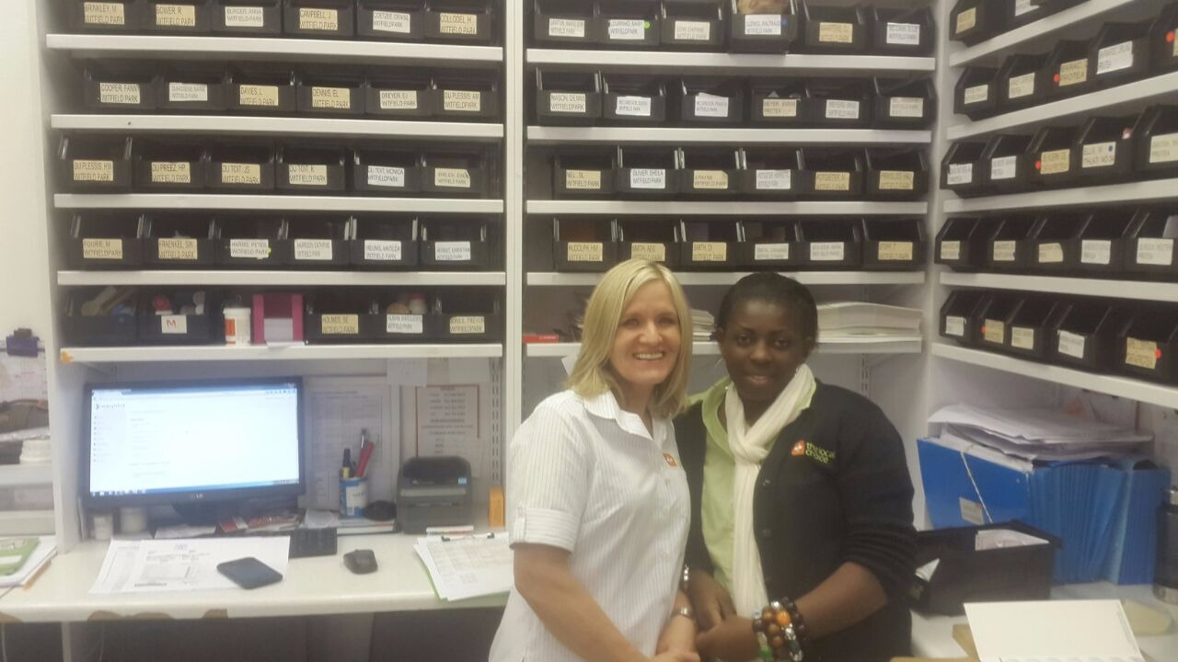


Slide 29






Slide 30


Before and After…

Slide 31


“With the blister packs, she can manage her own medicine and knows she is taking the right thing. It gives her independence.”
“Since I have used easyblist blister packs, my blood pressure has come down because I’m taking my pills regularly like I should.”
Jack Thornton

Slide 32


Drugs don’t work in patients who don’t take them
C. Everett Koop
Former U.S. Surgeon General
Thank you…
www.easyblist.co.za

