Slide 1
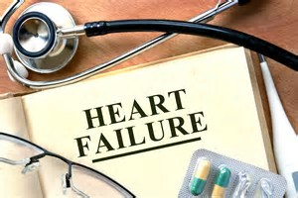

Slide 2
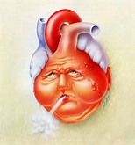
HEART FAILURE
March 2017
Presented by : Liana Grobler

Slide 3
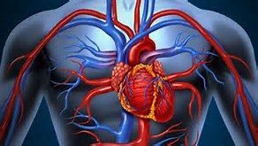
Position of the heart
Right side
Left side

Slide 4
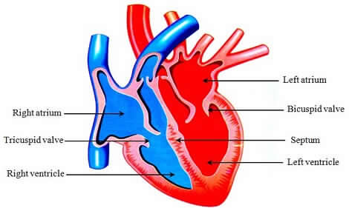
Structure

Slide 5
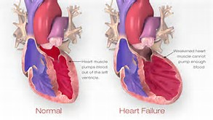

Slide 6
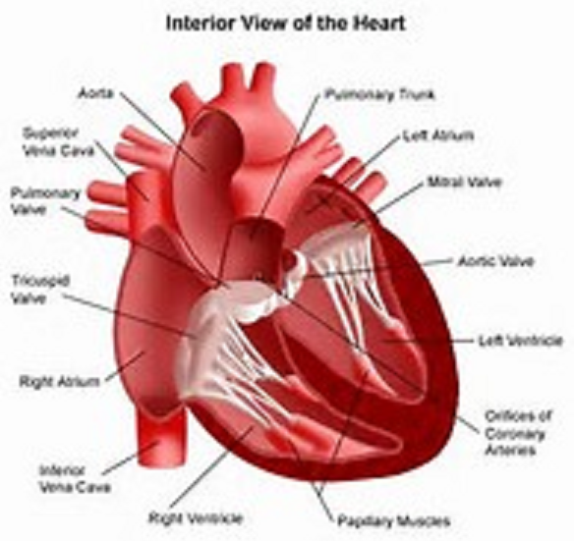
INTERIOR VIEW OF THE HEART
Aorta
Pulmonary Trachia
Super Vena Cava
Left Atrium
The heart has four chambers, two on the right and two on the left:
Two upper chambers called atria (one is an atrium)
Two lower chambers called ventricles
Bicuspidale Valve
Pulmonary Valve
Aortic Valve
Tricuspidale Valve
Right Ventricle
Right Atrium
Coronary Arteries
Interior Vena Cava
Right Ventricle
Heart Muscles

Slide 7
How the normal heart works
To……
The normal healthy heart is a strong, muscular pump a little larger than a fist. It pumps blood continuously through the circulatory system.
The right atria takes in oxygen-depleted blood from the rest of the body and sends it back out to the lungs through the right ventricle where the blood becomes oxygenated.
Oxygen-rich blood travels from the lungs to the left atrium, then on to the left ventricle, which pumps it to the rest of the body.
The heart pumps blood to the lungs and to all the body's tissues by a sequence of highly organized contractions of the four chambers. For the heart to function properly, the four chambers must beat in an organized way.
From…

Slide 8
What is Heart failure?
It is a chronic inability of the heart to maintain an adequate output of blood from one or both ventricles, resulting in pulmonary congestion and over distention of the vascular system and organs with blood and an inadequate blood supply to the body tissues.
Congestion within the blood vessels hampers the flow of body fluids, causing oedema.
Heart failure is also called congestive heart failure (CHF)

Slide 9
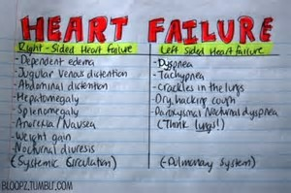

Slide 10
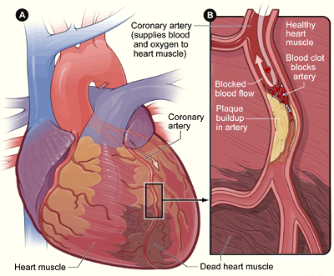
Heart with Muscle Damage and a Blocked Artery
Figure B is a cross-section of the coronary artery with plaque build-up and a blood clot.
Figure A is an overview of a heart and coronary artery showing damage (dead heart muscle) caused by a heart attack

Slide 11
Management
Look out for signs and symptoms as discussed
    Mild Chest pain
    Chest discomfort
    Extreme fatigue
    Profuse sweating
    Nausea or dizziness (You may also feel like you're about to pass out)
    Breathlessness
    Sleeplessness
    Anxiety
Moderate excersise
Medication
Regular check-ups
Close monitoring – this is serious but not an emergency

Slide 12
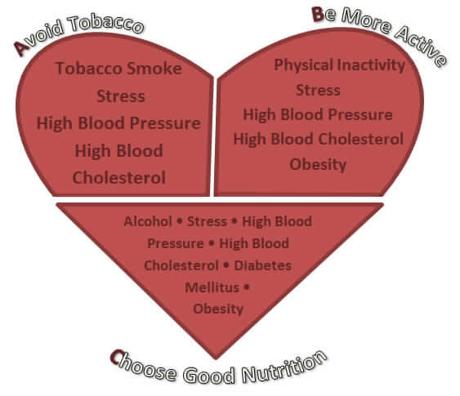
How to improve lifestyle
Stop smoking
Control your blood pressure
Control your cholesterol levels
Check for diabetes
Exercise
Eat a heart-healthy diet
Control your stress level

Slide 13
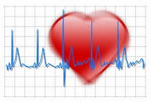
END

