Slide 1
OSTEOPOROSES
Presenter: Liana Grobler
2016

Slide 2
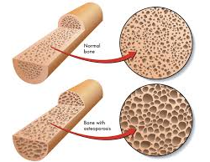

Slide 3
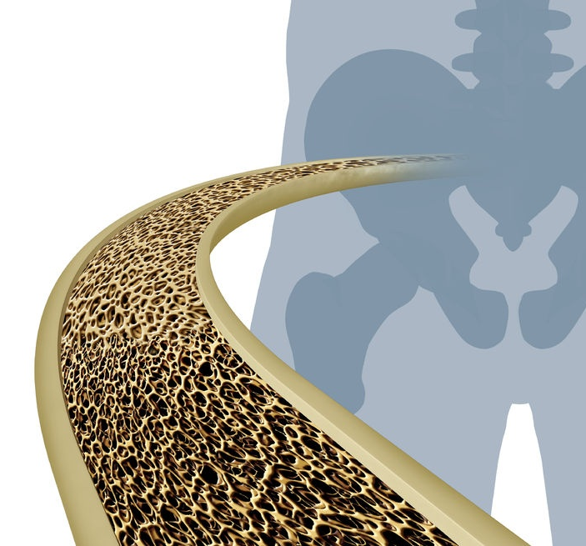
What is it?
It is a common metabolic disease that may cause the bones to become less dense, meaning the bones lose strength and become susceptible to fractures

Slide 4
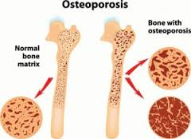
Will I get it?
Risk
Cured?
Prevented?
  One way to help prevent or reduce risk is to eat the correct food to build and maintain strong bones
  Foods rich in Calcium and Vit D naturally promotes bone health; others can actually be harmful if consumed excessively

Slide 5
Causes
(you cannot control…)
FAMILY HISTORY – If someone in your family has or had the disease it increases your risk
GENDER – Woman are simply more likely to develop Osteoporosis
ETHNICITY – White and Asian people are more likely to be affected than Black or Hispanic people (this however does not exclude them)
Upbringing and circumstances may contribute
You will lose +/- 5% bone mass per year after 50

Slide 6
Causes
(you can control…)
(partly out of your hands)
ESTROGEN LEVELS –
    Estrogen protects bones, low levels lead to higher risk.
    Menopause causes fast decrease in Estrogen levels – increase risk
    Woman may lose bone at a rate of 4-8% per year for several years after their ovaries stop producing Estrogen
    Ovaries produce high levels Estrogen – Hysterectomy will increase risk (medication for this)
    Irregular periods at young ages can indicate low Estrogen levels
    Irregular periods can also be from over exercising or under-eating, both increase bone loss
    MEN – Testosterone protects the bone. Low levels will increase risk
HISTORY OF BROKEN BONES –
    This is an indication of risk
    Broken bones can also lead to lowered Bone Mineral Density (BMD)
LOW BODY WEIGHT –
    Petite and small boned woman (under 130lbs) have less bone mass to begin with and therefore the increased risk

Slide 7
Causes
(you CAN control…)
DIET – Some food promotes bone growth and others may stunt it
CALCIUM
Quantity you need varies by age
VIT D
Calcium NEEDS Vit D, without it your body cannot absorb Calcium efficiently
Without enough Vit D, some Calcium intake could go to waste
OTHER VITAMINS AND MINERALS
Phosphorous, Magnesium, Vit K, Vit B6, Vit B12 are also important to bone growth
Well balanced diet can ensure you get the correct balance
If diet is not correct or sufficient then supplements can be taken

Slide 8
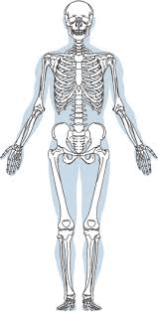
Causes
(you CAN control…)
DIET – Sometimes having too much of something in your diet can harm your bones (Everything in moderation)
YOU SHOULD MONITOR YOUR INTAKE OF:
PROTEIN:
Right amount
Too much can make you lose Calcium
CAFFEIN:
Too much limits the absorption

Slide 9
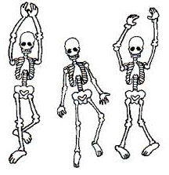
Causes
(you can control…)
(partly out of your hands)
EXERCISE –
    Without exercise risk increases
    A mix of weight bearing exercise (e.g. walking) and strengthening exercises (e.g. weight lifting)
SMOKING –
    Increases risk
    E.g. the chemicals makes it harder for your body to use Calcium, PLUS
    They make it harder for Estrogen to do one of its jobs … to protect your bones
ALCOHOL –
    Usually abuse of alcohol
    Can lower your calcium supply and influence how efficiently the body uses Calcium

Slide 10
Medical Conditions (influences)
Osteoporosis can be caused by a medical condition or medication – called secondary Osteoporosis
INTESTINAL PROBLEMS
Can interfere with absorption of Calcium and Vit D
Harder for the body to regenerate bones
E.g. Inflammatory bowel disease
THYROID AND PARATHYROID PROBLEMS
Hyperparathyroidism – the body creates too much (PTH) Parathyroid hormones – leads to bone loss
Hyperthyroidism – too much thyroid hormone – potentially weakening your bones
KIDNEY PROBLEMS
Can cause Calcium loss, upsetting the balance of bone loss and growth
NUTRIENT ABSORBTION PROBLEMS
People with Celiac disease have trouble absorbing nutrients like Calcium and Vit D

Slide 11
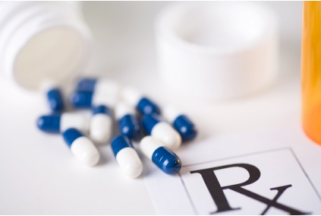
Medication (influences)
NOT AN EXHAUSTIVE LIST
Corticosteroids:
Prednisone is a corticosteroid that can cause excessive bone loss
Thyroid hormones:
Medication for an underactive thyroid – too much will weaken your bones
Some anti-convulsants or anti-seizure medication:
e.g. Dilantin
Antacids with Aluminum:

Slide 12
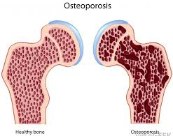
Osteopenia or Osteoporosis?
Difference in bone mineral density
Ostopenia
Commonly in people over 50 who do not have Osteoporosis
Calcium levels in bone is measured (BMD)
Decrease/Thinning in bone mass
Not usually considered to be “severe”
Serious risk factor for development of Osteoporosis

Slide 13
STAGES
Ostopenia / Osteoporosis
Normal bone
Osteoporosis
Strong bone
Strong bone

Slide 14
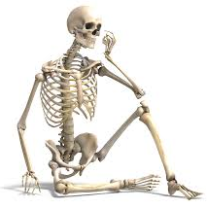
If Osteoporosis progresses…
Can lead to:
Loss of height
Stooped posture
Humpback
Severe pain

Slide 15
Dietary tips
Reduce amount of protein e.g. meat – this will help to prevent too much calcium being excreted from the body
Avoid carbohydrated beverages, even those labelled sugar free - not good for calcium absorption
Increase calcium in diet. Dietary products, green leafy veggies and legumes is a great source
Use low fat products
Other products e.g. orange juice have added calcium
Increase Vit D – get at least 15 direct sunshine exposure per day. If not possible then supplement with calcium 1000-1300mg / day
Excersise – low impact aerobics, jogging, walking …
Supplements
Only if all else fails
Consult your doctor or dietician
Critical elements for Osteoporosis is Calcium and Vit D

Slide 16
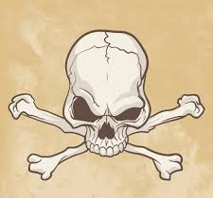
THE END

