Slide 1
STROKE

Slide 2
CONTENTS
Introduction
Statistics
Symptoms
Diagnosis
Treatment
Prevention
Conclusion
Case study
References

Slide 3
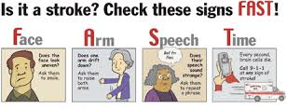

Slide 4
INTRODUCTION
Stroke – blood flow to brain obstructed
- lack of O2 in brain
CLASSIFICATION
Ischemic stroke
Thrombotic stroke
Embolic stroke
Hemorrhagic stroke
Intracerebral hemorrhage
Subarachnoid hemorrhage

Slide 5


Types
Ischemic Stroke
Haemorrhagig Stroke

Slide 6
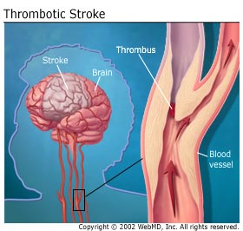
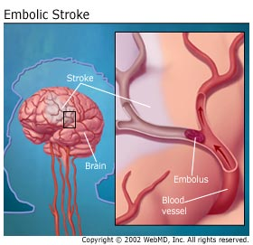
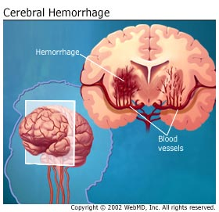
Figure 1: Thrombotic stroke
Figure 2: Embolic stroke
Figure 3: Cerebral hemorrhage

Slide 7
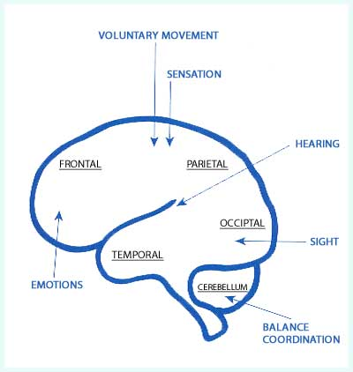
SYMPTOMS
Patients encounter problem in:
Movement
Communication
Sight
Numbness/paralysis
Headache
Figure 4: Part & function of brain

Slide 8
DIAGNOSIS
(A) Physical Examination
Demographic data
Vital signs
History taking
Motor assessment
Cranial assessment
Sensory assessment

Slide 9
(B) Lab & radiological investigation
1. Blood test
2. Brain imaging test
3. Heart & Blood vessel test
5. Electrocardiogram
4. Leg ultrasound
6. Transcranial Doppler (TCD)

Slide 10
1.Blood test
High cholesterol, sugar level, blood clotting time
2. Brain Imaging Test
Carotid ultrasonography- clotting in arteries leading to brain
3. Heart & Blood Vessel Test
CT Scan - detect bleeding in brain (hemorrhagic stroke)
MRI – detect damaged brain tissue
MRA (Magnetic Resonance Angiography) – visualize narrowing blood vessel
Catheter angiography (arteriography)

Slide 11
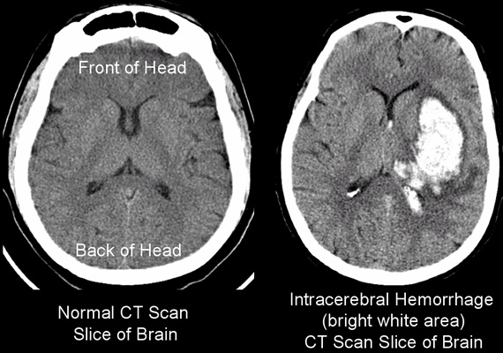
Figure 5: CT Scan result

Slide 12
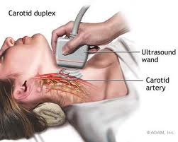
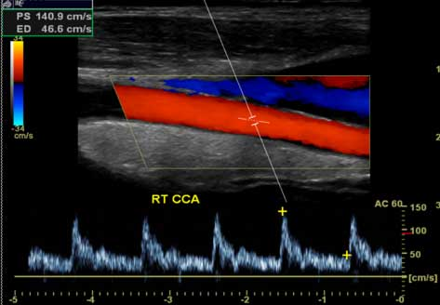

(a)
(b)
(c)
Figure 6: (a) Carotid Ultrasound
(b) Result(normal)
(c) Result (narrowing)

Slide 13
5. Electrocardiogram (ECG)
Identify problem with electrical conduction of heart
Regular heart beat rhythmic pattern smooth blood flow
Defect arrhythmia form blood clot stroke
6. Transcranial Doppler (TCD)
Sound waves – measure blood flow blood vessel of hemorrhagic area
Clot movement to brain leads to stroke
Detect blood clot in deep vein in legs
4. Leg Ultrasound

Slide 14
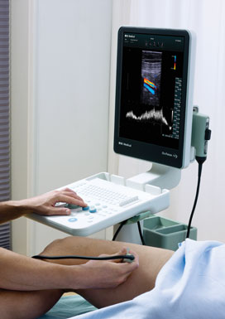
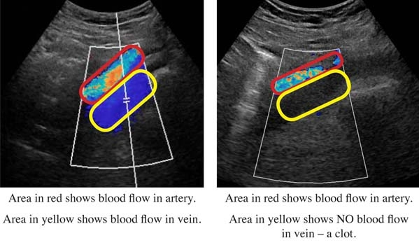
Figure 7: (a) Leg Ultrasound
(b)Result

Slide 15
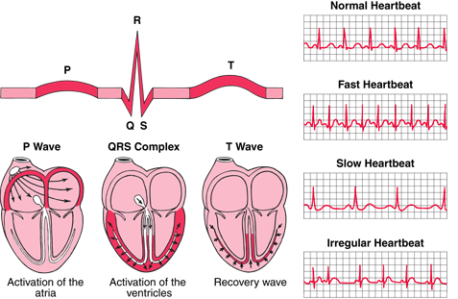
Figure 8: Result of Electrocardiogram (ECG)

Slide 16
TREATMENT
MEDICATION
1. Alteplase (tissue plasminogen activator- TPA)
Injected to vein in arm
Given 4½ hour after onset of symptoms
2. Anticoagulant
Drugs to thin blood
Ex: Aspirin, Heparin, Warfarin
Dissolve blood clot – restore blood flow
3. Statin
Reduce cholesterol in blood
Block enzyme in liver

Slide 17
(B) SURGERY
1. Carotid endarterectomy
Incision in neck
open carotid artery
2. Craniotomy
Small section of skull cut away
Remove blood clot / repair burst in blood vessel
remove fatty acids

Slide 18
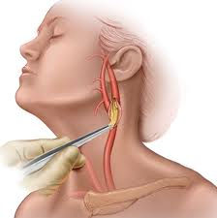
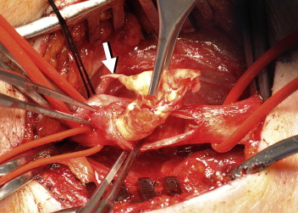
Figure 9: Carotid Endarterectomy

Slide 19
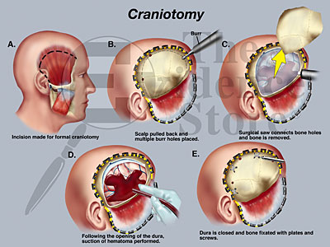
Figure 10: Craniotomy

Slide 20
PREVENTION
Steps
Diet
(low fat, high fiber)
Quit smoking & alcohol intake
Controlling diabetes
Avoiding illicit drugs
Maintain healthy weight
Exercise

Slide 21
COMPLICATIONS
1. Dysphagia
Interruption in normal swallowing
Small particles enter respiratory tract
2. Hydrocephalus
Too much CSF in brain cavities
Hemorrhagic stroke- stop CSF draining- accumulated
Prevention:
1. anti-clotting medicines
2. Compression stocking
3. Deep Vein Thrombosis (DVT)
Blood clot in leg
Prevention: Feeding tube
Prevention: placing tube into brain
Slow blood flow in veins – increase BP

Slide 22
CONCLUSION
Stroke - sudden death of brain cells due to lack of oxygen
Caused by blockage of blood flow / rupture of artery to the brain
Symptoms: weakness / paralysis on one side of the body
difficulty with balance, speaking, swallowing
Clot-busting drugs like TPA can be used to reverse a stroke
Prevention - minimizing risk factors
(controlling high blood pressure, high cholesterol, diabetes)

Slide 23
CASE STUDY
Patient’s detail
54 year old female, indian
Hemorrhagic stroke and suffered from left hemiplegia
No major improvements were noted for almost 3 years

Slide 24
Investigation
MRI of brain showed chronic infarct in the right fronto-
parietal and thalamocapsular regions
No acute infarct was seen
The patient had left sided hemiplegia, unable to sit,
stand and walk
Neuropsychological assessment showed speed of
processing and reaction time was impaired

Slide 25
Abstraction and fluency impaired
Deficits in working memory, problem solving,
sequencing, judgment and set shifting
Her visuoconstructive ability, visual memory and
learning were impaired

Slide 26
Treatment
Stem cell therapy - autologous bone marrow and
allogeneic cord blood stem cell transplantation

Slide 27
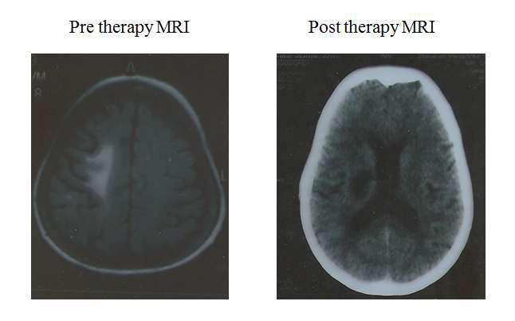
Figure 11: Comparison of brain before and after therapy

Slide 28


Slide 29
REFERENCES
PubMed Health, (2013), Classification of stroke, Viewed on 27th February 2013, http://www.ncbi.nlm.nih.gov/pubmedhealth/PMH0001740/
WebMD, (2013), Stroke, Viewed on 27th February 2013, http://www.webmd.com/stroke/guide/default.htm
Mayoclinic, (2012), Symptoms, Viewed on 27th February 2013, http://www.mayoclinic.com/health/stroke/DS00150/DSECTION=symptoms
NASAM, (2013), Statistics, Viewed on 27th February 2013, http://www.nasam.org
MSH, (2010), Statistics, Viewed on 27th February 2013, http://www.msh.org.my
Dexter Morris, (2013),Stroke diagnosis, Viewed on 27th^{th} February 2013, http://www.emedicinehealth.com/stroke

Slide 30
Jose Vega, (2013),Causes of stroke, Viewed on 27th^{th} February 2013, http://stroke.about.com/od/causesofstroke/
Mayoclinic, (2012),Stroketreatment and drugs, Viewed on 28th^{th} February 2013, http://www.mayoclinic.com/health/stroke/treatments-and-drugs
Stroke center, (2013),Stroke diagnosis and treatment, Viewed on 28th^{th} February 2013, http://www.strokecenter.org/patients/about-stroke/diagnosis-and-treatment/
NHS, (2012),Stroke condition, Viewed on 28th^{th} February 2013, http://www.nhs.uk/Conditions/Stroke/Pages/treatment
Purandare, C., Belle, V., Shitole, D.G., Joshi, M. (2012), Stem Cell Therapy for Hemorrhagic Stroke: A Single Case Study Report. A Journal of Neuroscience. 2(2): 22-26

